Slide 1
Enhancing Performance with PIPELINING

Slide 2
Pipelining
Pipeline concepts
Hazards
Example

Slide 3
Pipelined vs. Single-Cycle Instruction Execution
P
r
o
g
r
a
m
2
4
6
8
1
0
1
2
1
4
1
6
1
8
e
x
e
c
u
t
i
o
n
T
i
m
e
o
r
d
e
r
Single-cycle
(
i
n
i
n
s
t
r
u
c
t
i
o
n
s
)
l
w
$
1
,
1
0
0
(
$
0
)
I
n
s
t
r
u
c
t
i
o
n
R
e
g
A
L
U
D
a
t
a
R
e
g
f
e
t
c
h
a
c
c
e
s
s
l
w
$
2
,
2
0
0
(
$
0
)
8
n
s
I
n
s
t
r
u
c
t
i
o
n
R
e
g
A
L
U
D
a
t
a
R
e
g
f
e
t
c
h
a
c
c
e
s
s
l
w
$
3
,
3
0
0
(
$
0
)
8
n
s
I
n
s
t
r
u
c
t
i
o
n
f
e
t
c
h
.
.
.
8
n
s
Assume 2 ns for memory access, ALU operation; 1 ns for register access:
therefore, single cycle clock 8 ns; pipelined clock cycle 2 ns.
P
r
o
g
r
a
m
2
4
6
8
1
0
1
2
1
4
e
x
e
c
u
t
i
o
n
T
i
m
e
o
r
d
e
r
(
i
n
i
n
s
t
r
u
c
t
i
o
n
s
)
I
n
s
t
r
u
c
t
i
o
n
D
a
t
a
l
w
$
1
,
1
0
0
(
$
0
)
f
e
t
c
h
R
e
g
A
L
U
a
c
c
e
s
s
R
e
g
Pipelined
l
w
$
2
,
2
0
0
(
$
0
)
2
n
s
I
n
s
t
r
u
c
t
i
o
n
R
e
g
A
L
U
D
a
t
a
R
e
g
f
e
t
c
h
a
c
c
e
s
s
I
n
s
t
r
u
c
t
i
o
n
D
a
t
l
w
$
3
,
3
0
0
(
$
0
)
2
n
s
R
e
g
A
a
L
U
R
f
e
g
e
t
c
h
a
c
c
e
s
s
2
n
s
2
n
s
2
n
s
2
n
s
2
n
s
Notes:
‹#›

Slide 4
Pipeline Implementation
Pipelining
Goal of MIPS: (Clock cycles Per Instruction) CPI <= 1
Some instructions take longer to execute than others
Don’t want cycle time to depend on slowest instruction
Want 100% hardware utilization
Split execution of each instruction into several, balanced “stages”
Each stage is a block of combinational logic
Latency of each stage fits within 1 clock cycle
Insert registers between each pipeline stage to hold intermediate results
Execute each of these steps in parallel for a sequence of instructions

Slide 5
Pipelining MIPS
MIPS characteristics make pipelining easy
All instructions are approx. same length
Fetch and decode stages are similar for all instructions
Just a few instruction formats
Simplifies instruction decode and makes it possible in one stage
Memory operands appear only in load/stores
Memory access can be deferred to exactly one later stage
Operands are aligned in memory
One data transfer instruction requires one memory access stage
Notes:
‹#›

Slide 6
MIPS pipeline stages
Fetch (IF)
Read next instruction from memory
Increment address counter
Decode (ID)
Read register operands,
Resolve instruction in control signals
Compute branch target
Execute (EX)
Execute arithmetic/resolve branches
Memory (MEM)
Perform load/store accesses to memory
Take branches
Write back (WB)
Write arithmetic results to register file

Slide 7
Pipelined Datapath
Recall the 5 steps in instruction execution
Instruction Fetch & PC Increment (IF)
Instruction Decode and Register Read (ID)
Execution or calculate address (EX)
Memory access (MEM)
Write result into register (WB)

Slide 8

Review - Single-Cycle Datapath “Steps”
ADD
4
ADD
PC
<<2
ADDR
RD
Instruction
I
Instruction
32
16
32
5
5
5
Memory
RN1
RN2
WN
Register File
RD1
ALU
Zero
WD
RD2
M
U
ADDR
X
Data
E
Memory
RD
M
16
X
32
U
T
WD
X
N
D
IF
Instruction Fetch
ID
Instruction Decode
EX
Execute/ Address Calc.
MEM
Memory Access
WB
Write Back

Slide 9
Pipelined Datapath – Key Idea
What happens if we break the execution into multiple cycles, but keep the extra hardware?
Answer: We may be able to start executing a new instruction at each clock cycle - pipelining
…but we shall need extra registers to hold data between cycles – pipeline registers

Slide 10
Pipelined Datapath
Pipeline registers
wide enough to hold data coming in
ADD
4
64 bits
128 bits
ADD
PC
<<2
97 bits
64 bits
ADDR
RD
Instruction
I
Instruction
32
16
32
5
5
5
Memory
RN1
RN2
WN
RD1
Zero
Register File
ALU
WD
RD2
M
U
ADDR
X
Data
E
Memory
RD
M
16
X
32
U
T
WD
X
N
D
IF/ID
ID/EX
EX/MEM
MEM/WB

Slide 11
Pipelined Datapath
Pipeline registers
wide enough to hold data coming in
ADD
4
64 bits
128 bits
ADD
PC
<<2
97 bits
64 bits
ADDR
RD
Instruction
I
Instruction
32
16
32
5
5
5
Memory
RN1
RN2
WN
RD1
Zero
Register File
ALU
WD
RD2
M
Hazard-Situation that would cause incorrect execution
U
ADDR
X
Data
E
Memory
RD
M
16
X
32
U
T
WD
X
N
D
IF/ID
ID/EX
EX/MEM
MEM/WB
Only data flowing right to left may cause hazard…, why?

Slide 12
Bug in the Datapath
IF/ID
ID/EX
EX/MEM
MEM/WB
ADD
4
ADD
PC
<<2
ADDR
RD
Instruction
I
Instruction
32
16
32
5
5
5
Memory
RN1
RN2
WN
Register File
RD1
ALU
WD
RD2
M
U
ADDR
X
Data
E
Memory
RD
M
16
X
32
U
T
WD
X
N
D
Write register number comes from another later instruction!

Slide 13

Corrected Datapath
IF/ID
ID/EX
EX/MEM
MEM/WB
ADD
64 bits
133 bits
ADD
4
102 bits
69 bits
<<2
PC
ADDR
RD
32
5
RN1
RD1
Zero
Instruction
RN2
ALU
Memory
5
Register
5
WN
File
RD2
WD
M
ADDR
U
X
Data
E
Memory
RD
M
16
X
32
U
T
WD
X
N
5
D
Destination register number is also passed through ID/EX, EX/MEM
and MEM/WB registers, which are now wider by 5 bits

Slide 14
Pipelined Example
Consider the following instruction sequence:
lw $t0, 10($t1)
sw $t3, 20($t4)
add $t5, $t6, $t7
sub $t8, $t9, $t10

Slide 15
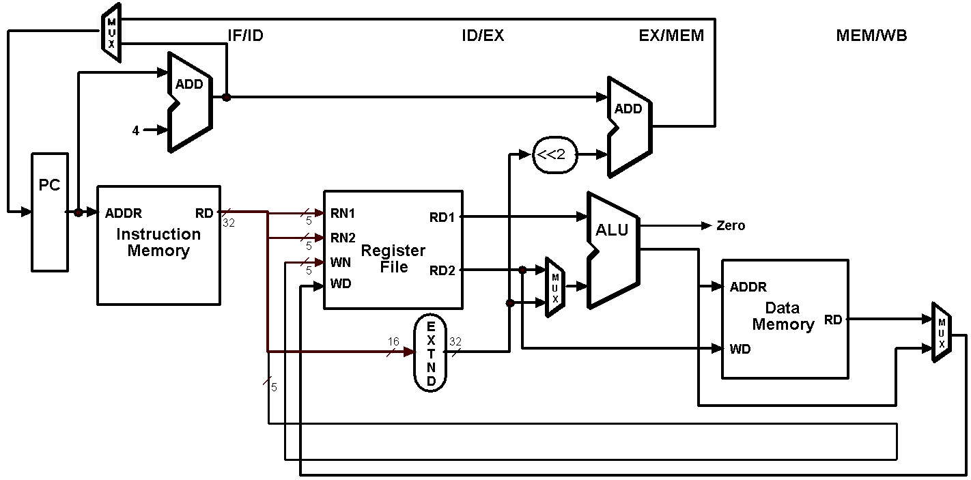
Single-Clock-Cycle Diagram: Clock Cycle 1
LW
lw $t0, 10($t1)
sw $t3, 20($t4)
add $t5, $t6, $t7
sub $t8, $t9, $t10

Slide 16
Single-Clock-Cycle Diagram: Clock Cycle 2
SW
LW
lw $t0, 10($t1)
sw $t3, 20($t4)
add $t5, $t6, $t7
sub $t8, $t9, $t10

Slide 17
Single-Clock-Cycle Diagram: Clock Cycle 3
ADD
SW
LW
lw $t0, 10($t1)
sw $t3, 20($t4)
add $t5, $t6, $t7
sub $t8, $t9, $t10

Slide 18
Single-Clock-Cycle Diagram: Clock Cycle 4
SUB
ADD
SW
LW
lw $t0, 10($t1)
sw $t3, 20($t4)
add $t5, $t6, $t7
sub $t8, $t9, $t10

Slide 19
Single-Clock-Cycle Diagram: Clock Cycle 5
SUB
ADD
SW
LW
lw $t0, 10($t1)
sw $t3, 20($t4)
add $t5, $t6, $t7
sub $t8, $t9, $t10

Slide 20
Single-Clock-Cycle Diagram: Clock Cycle 6
SUB
ADD
SW
lw $t0, 10($t1)
sw $t3, 20($t4)
add $t5, $t6, $t7
sub $t8, $t9, $t10

Slide 21
Single-Clock-Cycle Diagram: Clock Cycle 7
SUB
ADD
lw $t0, 10($t1)
sw $t3, 20($t4)
add $t5, $t6, $t7
sub $t8, $t9, $t10

Slide 22
Single-Clock-Cycle Diagram: Clock Cycle 8
SUB
lw $t0, 10($t1)
sw $t3, 20($t4)
add $t5, $t6, $t7
sub $t8, $t9, $t10

Slide 23
Represent Pipelines Graphically
Multiple instruction execution over multiple clock cycles
Instructions are listed in execution order from top to bottom
Clock cycles move from left to right
Show the use of resources at each stage and each cycle

Slide 24
Represent Pipelines Graphically
Lw $t6, 8($s5)
Add $s1, $s2, $s3
Ori $s4, $t3, 7
Sub $t5, $s2, $t3
Sw $s2, 10($t3)

Slide 25
Graphically Representing Pipelines
Time (in cycles)
CC1
CC2
CC3
CC4
CC5
CC6
CC7
CC8
lw $t6, 8($s5)
add $s1, $s2, $s3
ori $s4, $t3, 7
sub $t5, $s2, $t3
sw $s2, 10($t3)
Reg
DM
Reg
lw $t6, 8($s5)
IM
ALU
add $s1, $s2, $s3
IM
Reg
ALU
DM
Reg
Program Execution Order
ori $s4, $t3, 7
IM
Reg
ALU
DM
Reg
sub $t5, $s2, $t3
IM
Reg
ALU
DM
Reg
sw $s2, 10($t3)
IM
Reg
ALU
DM

Slide 26
Instruction-Time Diagram
Instruction-Time Diagram shows:
Which instruction occupying what stage at each clock cycle
Instruction flow is pipelined over the 5 stages
Lw $t7, 8($s3)
Lw $t6, 8($st)
Ori $t4, $s3, 7
Sub $s5, $s2, $t3
Sw $s2, 10($s3)

Slide 27
Instruction-Time Diagram
Up to five instructions can be in the pipeline during the same cycle
Instruction Level Parallelism (ILP)
ALU instructions skip the MEM stage. Store instructions skip the WB stage
lw $t7, 8($s3)
IF
ID
EX
MEM
WB
lw $t6, 8($s5)
IF
ID
EX
MEM
WB
Instruction Order
ori $t4, $s3, 7
IF
ID
EX
–
WB
sub $s5, $s2, $t3
IF
ID
EX
–
WB
sw $s2, 10($s3)
IF
ID
EX
MEM
–
CC1
CC2
CC3
CC4
CC5
CC6
CC7
CC8
CC9
Time
How many Clock Cycles?
5 Instructions + (5 step pipelining - 1) = 9 Clock cycles

Slide 28
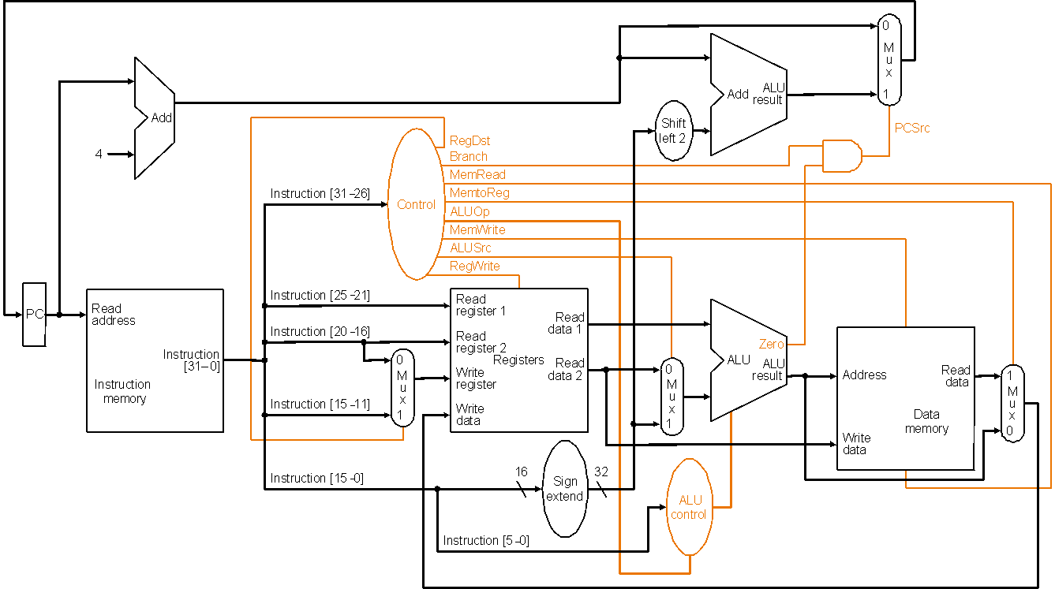
Recall Single-Cycle Control – the Datapath

Slide 29
Recall Single-Cycle – ALU Control
Instruction AluOp Instruction Funct Field Desired ALU control
opcode operation ALU action input
LW 00 load word xxxxxx add 010
SW 00 store word xxxxxx add 010
Branch eq 01 branch eq xxxxxx subtract 110
R-type 10 add 100000 add 010
R-type 10 subtract 100010 subtract 110
R-type 10 AND 100100 and 000
R-type 10 OR 100101 or 001
R-type 10 set on less 101010 set on less 111
ALUOp
Funct field
Operation
ALUOp1
ALUOp0
F5
F4
F3
F2
F1
F0
0
0
X
X
X
X
X
X
010
0
1
X
X
X
X
X
X
110
1
X
X
X
0
0
0
0
010
1
X
X
X
0
0
1
0
110
1
X
X
X
0
1
0
0
000
1
X
X
X
0
1
0
1
001
1
X
X
X
1
0
1
0
111
Truth table for ALU control bits

Slide 30
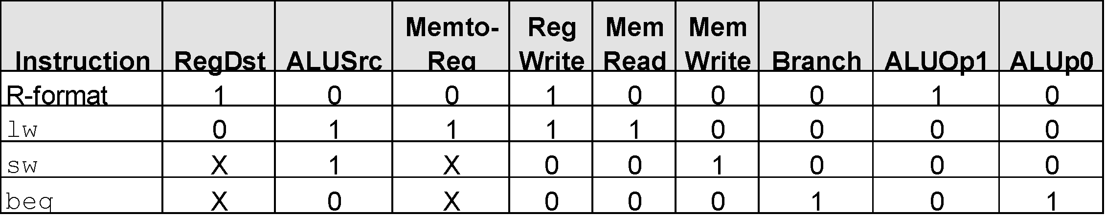
Recall Single-Cycle – Control Signals
Effect of control bits
Signal Name Effect when deasserted Effect when asserted
RegDst The register destination number for the The register destination number for the
Write register comes from the rt field (bits 20-16) Write register comes from the rd field (bits 15-11)
RegWrite None The register on the Write register input is written
with the value on the Write data input
AlLUSrc The second ALU operand comes from the The second ALU operand is the sign-extended,
second register file output (Read data 2) lower 16 bits of the instruction
PCSrc The PC is replaced by the output of the adder The PC is replaced by the output of the adder
that computes the value of PC + 4 that computes the branch target
MemRead None Data memory contents designated by the address
input are put on the first Read data output
MemWrite None Data memory contents designated by the address
input are replaced by the value of the Write data input
MemtoReg The value fed to the register Write data input The value fed to the register Write data input
comes from ALU comes from the data memory
Deter-
mining
control
bits

Slide 31
Pipeline Control
Initial design – motivated by single-cycle datapath control – use the same control signals
Modified Signals:
No separate write signal for the PC as it is written every cycle
No separate write signals for the pipeline registers as they are written every cycle
No separate read signal for instruction memory as it is read every clock cycle
No separate read signal for register file as it is read every clock cycle
Need to set control signals during each pipeline stage
Since control signals are associated with components active during a single pipeline stage, can group control lines into five groups according to pipeline stage
Will be
modified
by hazard
detection
unit!!

Slide 32
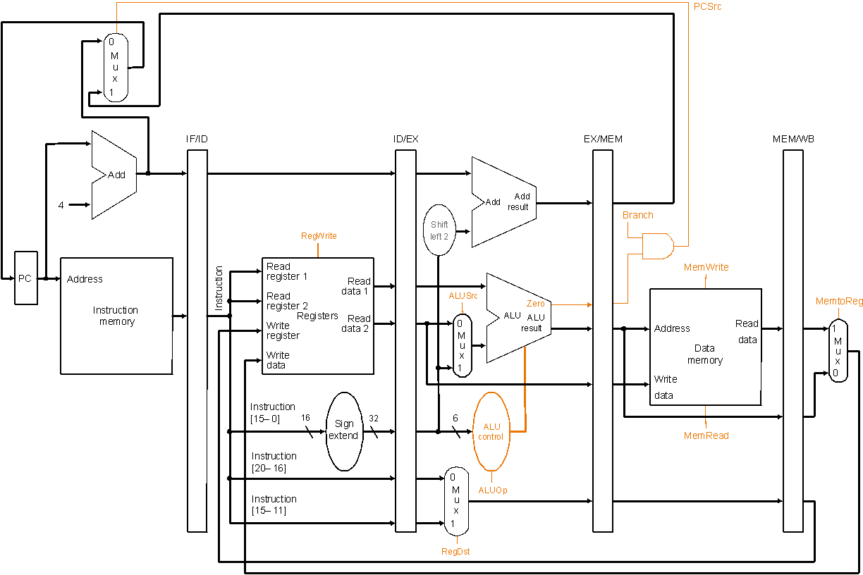
Pipelined Datapath with Control I
Same control
signals as the
single-cycle
datapath
Notes:
‹#›

Slide 33
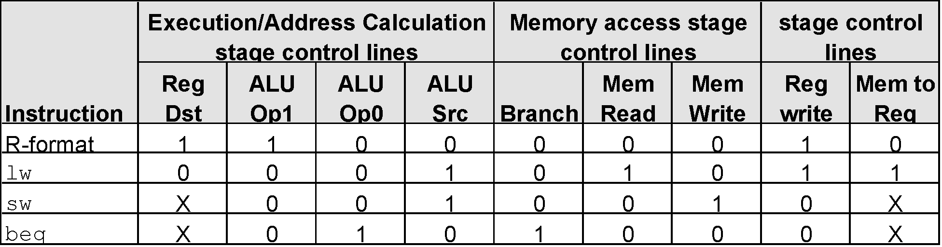
Pipeline Control Signals
There are five stages in the pipeline
instruction fetch / PC increment
instruction decode / register fetch
execution / address calculation
memory access
write back
Nothing to control as instruction memory
read and PC write are always enabled
Notes:
‹#›

Slide 34
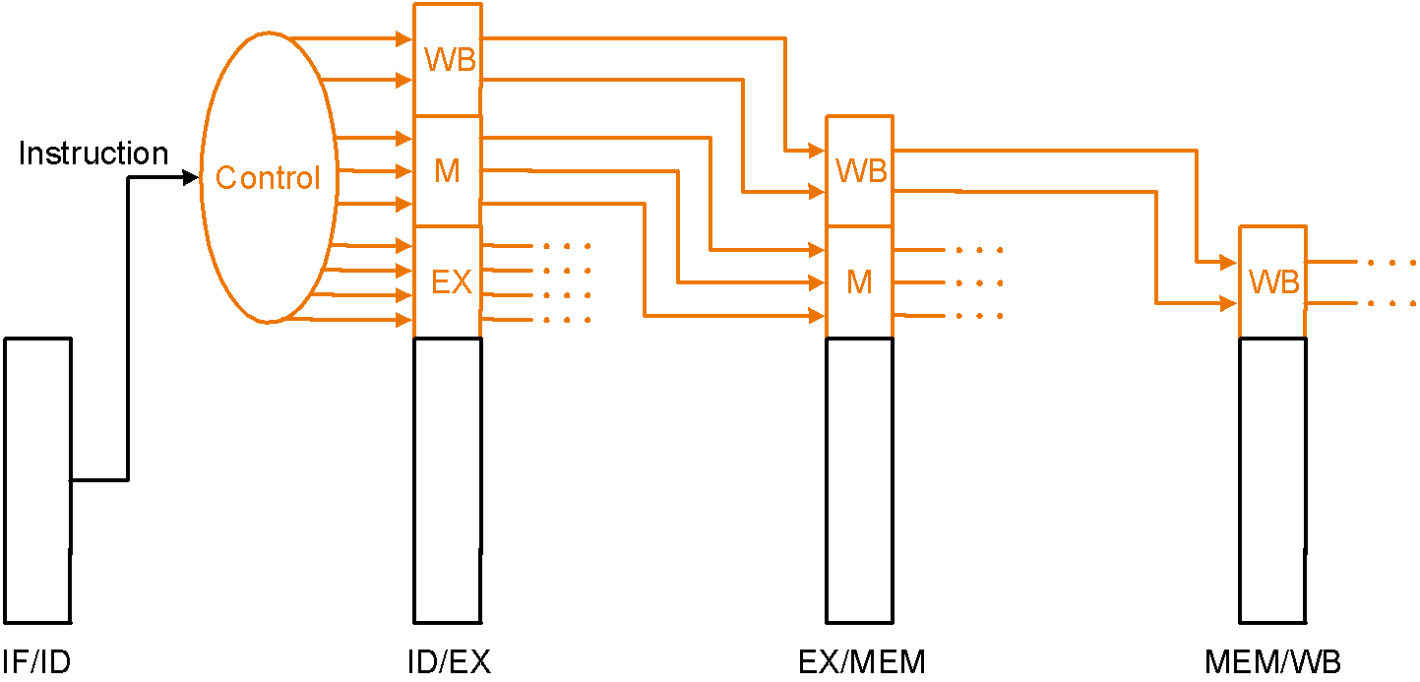
Pipeline Control Implementation
Pass control signals along just like the data – extend each pipeline register to hold needed control bits for succeeding stages
Note: The 6-bit funct field of the instruction required in the EX stage to generate ALU control can be retrieved as the 6 least significant bits of the immediate field which is sign-extended and passed from the IF/ID register to the ID/EX register
Notes:
‹#›

Slide 35
Pipeline Hazards
Situations that would cause incorrect execution
Data flow problems that arise as a result of pipelining
Limits the amount of parallelism, sometimes induces “penalties” that prevent one instruction per clock cycle
Types
Structural hazards
Data hazards
Control hazards

Slide 36
Hazards
Draw pipeline diagram, and check hazard is exist or not?
lw $1, 100($0)
lw $2, 200($0)
lw $3, 300($0)
lw $4, 400($0)

Slide 37
Hazard
e
x
e
c
u
2
4
6
8
1
0
1
2
1
4
t
i
o
n
T
i
m
e
o
r
d
e
r
(
i
n
i
n
s
t
r
u
c
t
i
o
n
s
)
l
w
$
1
,
1
0
0
(
$
0
)
I
n
s
t
r
u
c
t
i
o
n
R
e
g
A
L
U
D
a
t
a
R
e
g
f
e
t
c
h
a
c
c
e
s
s
l
w
$
2
,
2
0
0
(
$
0
)
2
n
s
I
n
s
t
r
u
c
t
i
o
n
R
e
g
A
L
U
D
a
t
a
R
e
g
f
e
t
c
h
a
c
c
e
s
s
I
n
s
t
r
u
c
t
i
o
n
D
a
t
l
w
$
3
,
3
0
0
(
$
0
)
2
n
s
R
e
g
A
a
L
U
R
f
e
g
e
t
c
h
a
c
c
e
s
s
lw $4, 400($0)
2
n
s
2
n
s
2
n
s
2
n
s
2
n
s

Slide 38
Structural Hazards
E.g., suppose single – not separate – instruction and data memory in pipeline below with one read port
then a structural hazard between first and fourth lw instructions
P
r
o
g
r
a
m
e
x
e
c
u
t
i
o
n
2
4
6
8
1
0
1
2
1
4
o
r
d
e
r
T
i
m
e
(
i
n
i
n
s
t
r
u
c
t
i
o
n
s
)
l
w
$
1
,
1
0
0
(
$
0
)
I
n
s
t
r
u
c
t
i
o
n
R
e
g
A
L
U
D
a
t
a
R
e
g
Pipelined
f
e
t
c
h
a
c
c
e
s
s
l
w
$
2
,
2
0
0
(
$
0
)
2
n
s
I
n
s
t
r
u
c
t
i
o
n
R
e
g
A
L
U
D
a
t
a
R
e
g
Hazard if single memory
f
e
t
c
h
a
c
c
e
s
s
l
w
$
3
,
3
0
0
(
$
0
)
2
n
s
I
n
s
t
r
u
c
t
i
o
n
R
e
g
A
L
U
D
a
t
a
R
e
g
f
e
t
c
h
a
c
c
e
s
s
l
w
$
4
,
4
0
0
(
$
0
)
I
n
s
t
r
u
c
t
i
o
n
R
e
g
A
L
U
D
a
t
a
R
e
g
2
n
s
f
e
t
c
h
a
c
c
e
s
s
2
n
s
2
n
s
2
n
s
2
n
s
2
n
s

Slide 39
Structural Hazards
Inadequate hardware to simultaneously support all instructions in the pipeline in the same clock cycle
Attempt to use the same hardware resource by two different instructions during the same cycle
Structural hazards can be overcome by adding additional hardware
lw $1, 100($0)
lw $2, 200($0)
lw $3, 300($0)
lw $4, 400($0)

Slide 40
Resolving Structural Hazards
Serious Hazard:
Hazard cannot be ignored
Easy to avoid
Solution: Add more hardware resources (more costly)
Add more additional hardware to eliminate the structural hazard
Like, two separate memories

Slide 41
Data Hazards
Dependency between instructions causes a data hazard
Instruction needs data from the result of a previous instruction still executing in pipeline
The dependent instructions are close to each other
Pipelined execution might change the order of operand access

Slide 42
Data Hazards Type
RAR (Read After Read) hazard
Occurs when two instructions both read from the same register
Example:
ADD $s1, $s2, $s3
SUB $s4, $s5, $s3
Both instructions reading $s3, creating a RAR hazard
Don't cause a problem for the processor because reading a register doesn't change the register‘s value

Slide 43
Data Hazards Type
RAW (Read After Write) hazard
Occurs when, one instruction reads a location after an earlier instruction writes new data to it
instruction j tries to read a source before instruction i writes it, so j incorrectly gets the old value
Example:
i: Add $s3, $s1, $s2
j: Add $s5, $s3, $s4
Result is the instruction reading stale data
Detected when Output_{n} register ($s3) and Input_{n+1} registers ($s3, $s4) contain at least one common register
Need to resolve

Slide 44
Data Hazards Type
WAR (Write After Read) hazard
Hazards occur when the output register of an instruction is used for write after read by a previous instruction
Instruction j tries to write a destination before it is read by instruction i, so i incorrectly gets the new value
Example:
i: Add $s3, $s1, $s2
j: Add $s1, $s3, $s4
Detected when Input_{n} register and Output_{n+1} register contain at least one common operand
Such hazards are rare

Slide 45
Data Hazards Type
WAW (Write After Write) hazard
Hazard occur when the output register of an instruction is used for write after written by a previous instruction
Example:
ADD $s1, $s2, $s3
SUB $s1, $s5, $s6 //Subtract writes the same register as the addition
If a processor executes instructions in the order that they appear in the program and uses the same pipeline for all instructions, WAR and WAW hazards do not cause the delays because of the way instructions flow through the pipeline

Slide 46
Hazard
Example: Draw pipeline diagram and show
the hazards if any.
sub $s2, $t1, $t3
add $s4, $s2, $t5
or $s6, $t3, $s2
and $s7, $t4, $s2
sw $t8, 10($s2)

Slide 47
RAW Data Hazard Solutions
Example:
sub $s2, $t1, $t3
add $s4, $s2, $t5
or $s6, $t3, $s2
and $s7, $t4, $s2
sw $t8, 10($s2)

Slide 48
RAW Data Hazard Solutions
Example:
sub $s2, $t1, $t3
add $s4, $s2, $t5
or $s6, $t3, $s2
and $s7, $t4, $s2
sw $t8, 10($s2)

Slide 49
Example of a RAW Data Hazard
Time (cycles)
CC1
CC2
CC3
CC4
CC5
CC6
CC7
CC8
value of $s2
10
10
10
10
10
20
20
20
sub $s2, $t1, $t3
IM
Reg
ALU
DM
Reg
add $s4, $s2, $t5
IM
Reg
ALU
DM
Reg
Program Execution Order
or $s6, $t3, $s2
IM
Reg
ALU
DM
Reg
and $s7, $t4, $s2
IM
Reg
ALU
DM
Reg
sw $t8, 10($s2)
IM
Reg
ALU
DM
Result of sub is needed by add, or, and, & sw instructions
Instructions add & or will read old value of $s2 from reg file
During CC5, $s2 is written at end of cycle, old value is read
But, can be eliminated by considering in first half write to register and in second half read from register

Slide 50
Solution 1: Stalling the Pipeline
Time (in cycles)
CC1
CC2
CC3
CC4
CC5
CC6
CC7
CC8
CC9
value of $s2
10
10
10
10
10
20
20
20
20
sub $s2, $t1, $t3
IM
Reg
ALU
DM
Reg
Instruction Order
add $s4, $s2, $t5
IM
Reg
Reg
Reg
Reg
ALU
DM
Reg
stall
stall
stall
or $s6, $t3, $s2
IM
Reg
ALU
DM
Three stall cycles during CC3 thru CC5 (wasting 3 cycles)
Stall cycles delay execution of add & fetching of or instruction
The add instruction cannot read $s2 until beginning of CC6
The add instruction remains in the Instruction register until CC6
The PC register is not modified until beginning of CC6

Slide 51
Solution 2: Forwarding ALU Result
The ALU result is forwarded (fed back) to the ALU input
No bubbles are inserted into the pipeline and no cycles are wasted
ALU result is forwarded from ALU, MEM, and WB stages
Time (cycles)
CC1
CC2
CC3
CC4
CC5
CC6
CC7
CC8
value of $s2
10
10
10
10
10
20
20
20
sub $s2, $t1, $t3
IM
Reg
ALU
DM
Reg
add $s4, $s2, $t5
IM
Reg
ALU
DM
Reg
Program Execution Order
or $s6, $t3, $s2
IM
Reg
ALU
DM
Reg
and $s7, $s6, $s2
IM
Reg
ALU
DM
Reg
sw $t8, 10($s2)
IM
Reg
ALU
DM

Slide 52
RAW Data Hazard Solutions
For the following code, detect the hazard, if any.
lw $s0, 20($t1)
sub $t2, $s0,$t3
Is forwarding useful?
If an R-type instruction following a load uses the result of the load – called load-use data hazard

Slide 53
RAW Data Hazard Solutions
Unfortunately, not all data hazards can be forwarded
Load has a delay that cannot be eliminated by forwarding
In the example shown below …
The LW instruction does not read data until end of CC4
Cannot forward data to ADD at end of CC3 - NOT possible
Time (cycles)
CC1
CC2
CC3
CC4
CC5
CC6
CC7
CC8
However, load can forward data to 2nd next and later instructions
lw $s2, 20($t1)
IF
Reg
ALU
DM
Reg
Program Order
add $s4, $s2, $t5
IF
Reg
ALU
DM
Reg
or $t6, $t3, $s2
IF
Reg
ALU
DM
Reg
and $t7, $s2, $t4
IF
Reg
ALU
DM
Reg

Slide 54
Stall the Pipeline for one Cycle
ADD instruction depends on LW 🡺 stall at CC3
Allow Load instruction in ALU stage to proceed
Freeze PC and Instruction registers (NO instruction is fetched)
Introduce a bubble into the ALU stage (bubble is a NO-OP)
Load can forward data to next instruction after delaying it
Time (cycles)
CC1
CC2
CC3
CC4
CC5
CC6
CC7
CC8
lw $s2, 20($s1)
IM
Reg
ALU
DM
Reg
add $s4, $s2, $t5
IM
stall
Program Order
bubble
Reg
ALU
DM
Reg
or $t6, $s3, $s2
IM
Reg
ALU
DM
Reg

Slide 55
Showing Stall Cycles
Stall cycles can be shown on instruction-time diagram
Hazard is detected in the Decode stage
Stall indicates that instruction is delayed
Instruction fetching is also delayed after a stall
Example:
Data forwarding is to be shown using green arrows
lw $s1, ($t5)
IF
ID
EX
MEM
WB
lw $s2, 8($s1)
IF
Stall
ID
EX
MEM
WB
add $v0, $s2, $t3
IF
Stall
ID
EX
MEM
WB
sub $v1, $s2, $v0
IF
ID
EX
MEM
WB
CC1
CC2
CC3
CC4
CC5
CC6
CC7
CC8
CC9
CC10
Time

Slide 56
Showing Stall Cycles
Stall cycles can be shown on instruction-time diagram
Hazard is detected in the Decode stage
Stall indicates that instruction is delayed
Instruction fetching is also delayed after a stall
Example:
Data forwarding is shown using green arrows
lw $s1, ($t5)
IF
ID
EX
MEM
WB
lw $s2, 8($s1)
IF
Stall
ID
EX
MEM
WB
add $v0, $s2, $t3
IF
Stall
ID
EX
MEM
WB
sub $v1, $s2, $v0
IF
ID
EX
MEM
WB
CC1
CC2
CC3
CC4
CC5
CC6
CC7
CC8
CC9
CC10
Time

Slide 57
RAW Data Hazard Solutions
Software Solution
Reordering Code to Avoid Pipeline Stall
Example:
lw $t0, 0($t1)
lw $t2, 4($t1)
sw $t2, 0($t1)
sw $t0, 4($t1)

Slide 58
RAW Data Hazard Solutions
Example:
lw $t0, 0($t1)
lw $t2, 4($t1)
sw $t2, 0($t1)
sw $t0, 4($t1)
Reordered code:
lw $t0, 0($t1)
lw $t2, 4($t1)
sw $t0, 4($t1)
sw $t2, 0($t1)
Data hazard
Interchanged

Slide 59
Example
Draw the pipelining execution for the following code and detect and resolve the hazard, if any.
sub $2, $1, $3
and $12, $2, $5
or $13, $6, $2
add $14, $2, $2
sw $15, 100($2)
$2 = 10 before sub
$2 = -20 after sub

Slide 60
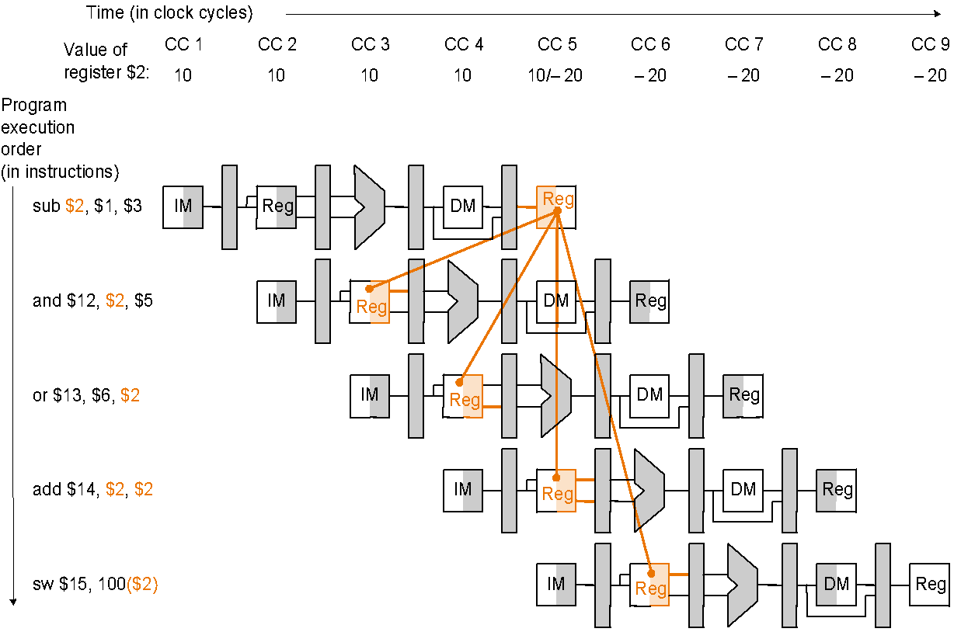
Data Hazards and Forwarding
$2 = 10 before sub;
$2 = -20 after sub
Notes:
‹#›

Slide 61
Example: Software Solution
By rearranging instructions to insert independent instructions between instructions that would otherwise have a data hazard between them,
Or, if such rearrangement is not possible, insert nops
Such compiler solutions may not always be possible, and nops slow the machine down
sub $2, $1, $3
and $12, $2, $5
or $13, $6, $2
add $14, $2, $2
sw $15, 100($2)
sub $2, $1, $3
lw $10, 40($3)
slt $5, $6, $7 and $12, $2, $5 or $13, $6, $2 add $14, $2, $2 sw $15, 100($2)
sub $2, $1, $3
nop
nop and $12, $2, $5 or $13, $6, $2 add $14, $2, $2 sw $15, 100($2)
or
MIPS: nop = “no operation” = 00…0 (32bits) = sll $0, $0, 0
Notes:
‹#›

Slide 62
RAW Hazard-Hardware Solution
Forwarding
Idea: Use intermediate data, do not wait for result to be finally written to the destination register.
Two steps:
Detect data hazard
Forward intermediate data to resolve hazard

Slide 63
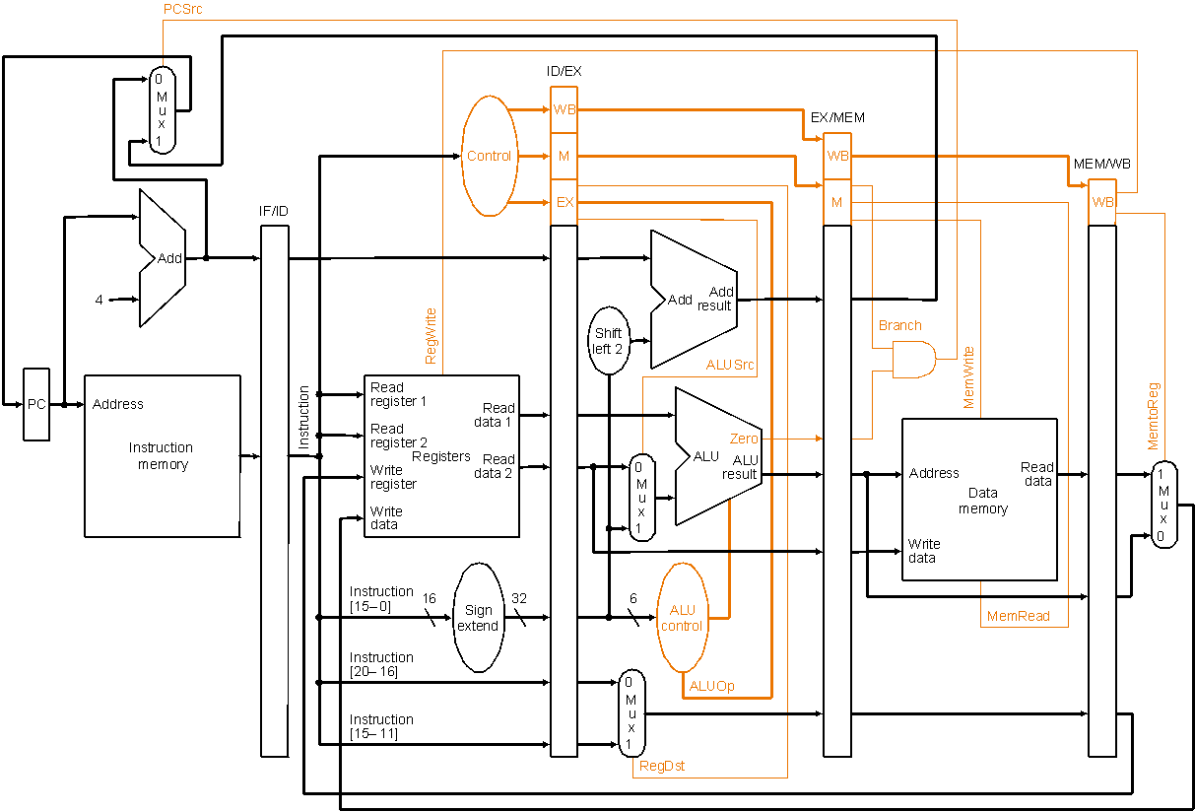
Pipelined Datapath with Control II (as before)
sub $2, $1, $3
and $12, $2, $5 or $13, $6, $2 add $14, $2, $2 sw $15, 100($2)
Control signals
emanate from
the control
portions of the
pipeline registers
Notes:
‹#›

Slide 64
Data Hazards and Forwarding
$2 = 10 before sub;
$2 = -20 after sub
First hazard between
sub $2, $1, $3 and
and $12, $2, $5 is detected
When the sub is in EX stage and the and is in ID stage because
EX/MEM.RegisterRd = ID/EX.RegisterRs = $2
Notes:
‹#›

Slide 65
Hazard Detection
Hazard conditions:
1a. EX/MEM.RegisterRd = ID/EX.RegisterRs
1b. EX/MEM.RegisterRd = ID/EX.RegisterRt
2a. MEM/WB.RegisterRd = ID/EX.RegisterRs
2b. MEM/WB.RegisterRd = ID/EX.RegisterRt
Eg., in the example, first hazard between
sub $2, $1, $3 and
and $12, $2, $5 is detected
When the sub is in EX stage and the and is in ID stage because
EX/MEM.RegisterRd = ID/EX.RegisterRs = $2 (1a)
sub $2, $1, $3
and $12, $2, $5 or $13, $6, $2 add $14, $2, $2 sw $15, 100($2)

Slide 66
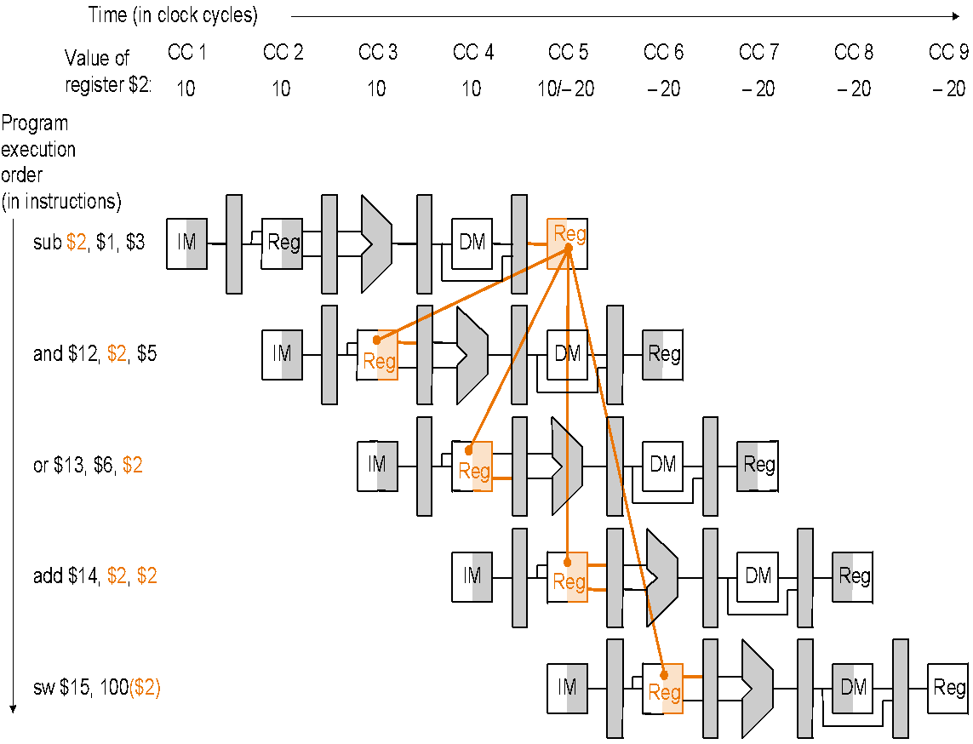
Hazard Detection
sub $2, $1, $3
and $12, $2, $5 or $13, $6, $2 add $14, $2, $2 sw $15, 100($2)
When the sub is in WB stage and the or is in ID stage
MEM/WB.RegisterRd = ID/EX.RegisterRt = $2 (2b)

Slide 67
Hazard Detection
Whether to forward also depends on:
if the later instruction is going to write a register
if not, no need to forward
if the destination register of the later instruction is $0
no need to forward value ($0 is always 0 and never overwritten)

Slide 68
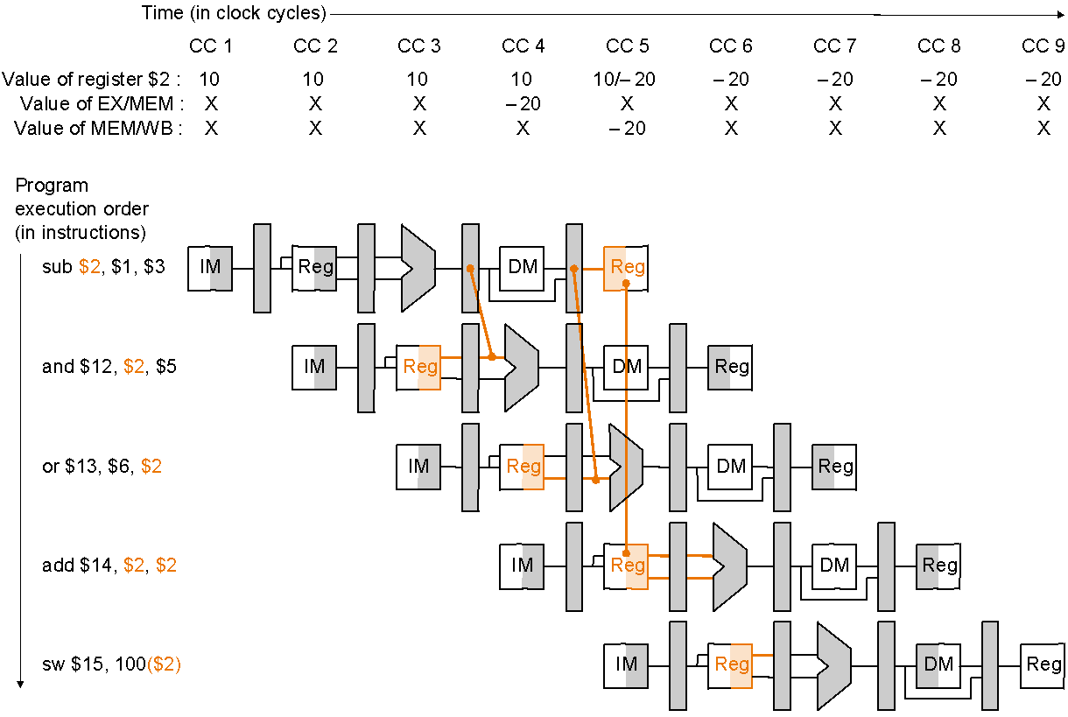
Data Forwarding
Plan:
Allow inputs to the ALU not just from ID/EX, but also later pipeline registers, and
Use multiplexors and control signals to choose appropriate inputs to ALU
sub $2, $1, $3
and $12, $2, $5
or $13, $6, $2
add $14, $2, $2
sw $15, 100($2)
Dependencies between pipelines move forward in time

Slide 69
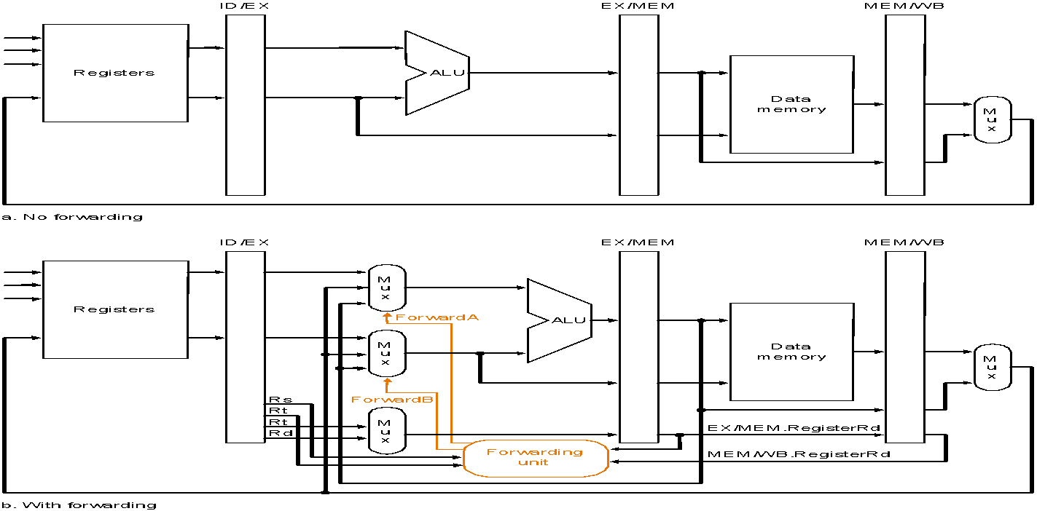
Datapath Before Forwarding Hardware
Datapath after adding forwarding hardware

Slide 70

Datapath after adding Forwarding Hardware
Forwarding Hardware

Slide 71
Forwarding Hardware: Multiplexor Control
Mux control Source Explanation
ForwardA = 00 ID/EX The first ALU operand comes from the register file
ForwardA = 10 EX/MEM The first ALU operand is forwarded from prior ALU result
ForwardA = 01 MEM/WB The first ALU operand is forwarded from data memory
or an earlier ALU result
ForwardB = 00 ID/EX The second ALU operand comes from the register file
ForwardB = 10 EX/MEM The second ALU operand is forwarded from prior ALU result
ForwardB = 01 MEM/WB The second ALU operand is forwarded from data memory
or an earlier ALU result
Depending on the selection in the rightmost multiplexor
(see datapath with control diagram)

Slide 72
Data Hazard: Detection and Forwarding
Forwarding unit determines multiplexor control according to the following rules:
EX hazard
if ( EX/MEM.RegWrite // if there is a write…
and ( EX/MEM.RegisterRd ≠ 0 ) // to a non-$0 register…
and ( EX/MEM.RegisterRd = ID/EX.RegisterRs ) ) // matches, then ForwardA = 10
if ( EX/MEM.RegWrite // if there is a write…
and ( EX/MEM.RegisterRd ≠ 0 ) // to a non-$0 register…
and ( EX/MEM.RegisterRd = ID/EX.RegisterRt ) ) // matches then… ForwardB = 10

Slide 73
Data Hazard: Detection and Forwarding
MEM hazard
if ( MEM/WB.RegWrite // if there is a write…
and ( MEM/WB.RegisterRd ≠ 0 ) // to a non-$0 register…
and ( EX/MEM.RegisterRd ≠ ID/EX.RegisterRs ) // and not already a //register match with earlier pipeline register…
and ( MEM/WB.RegisterRd = ID/EX.RegisterRs ) ) // but match with later //pipeline register, then…
ForwardA = 01
if ( MEM/WB.RegWrite // if there is a write…
and ( MEM/WB.RegisterRd ≠ 0 ) // to a non-$0 register…
and ( EX/MEM.RegisterRd ≠ ID/EX.RegisterRt ) // and not already a
// register match with earlier pipeline register…
and ( MEM/WB.RegisterRd = ID/EX.RegisterRt ) ) // but match with later pipeline register, then…
ForwardB = 01
This check is necessary, e.g., for sequences such as add $1, $1, $2; add $1, $1, $3; add $1, $1, $4;
(array summing…), where an earlier pipeline (EX/MEM) register has more recent data

Slide 74
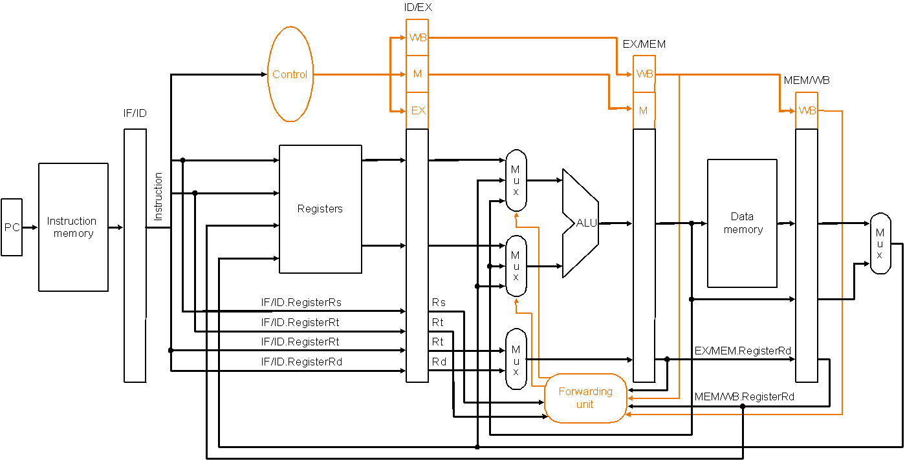
Forwarding Hardware with Control
Called forwarding unit, not hazard detection unit,
because once data is forwarded there is no hazard!
Datapath with forwarding hardware and control wires – certain details,
e.g., branching hardware, are omitted to simplify the drawing
Note: so far we have only handled forwarding to R-type instructions…!
Notes:
‹#›

Slide 75
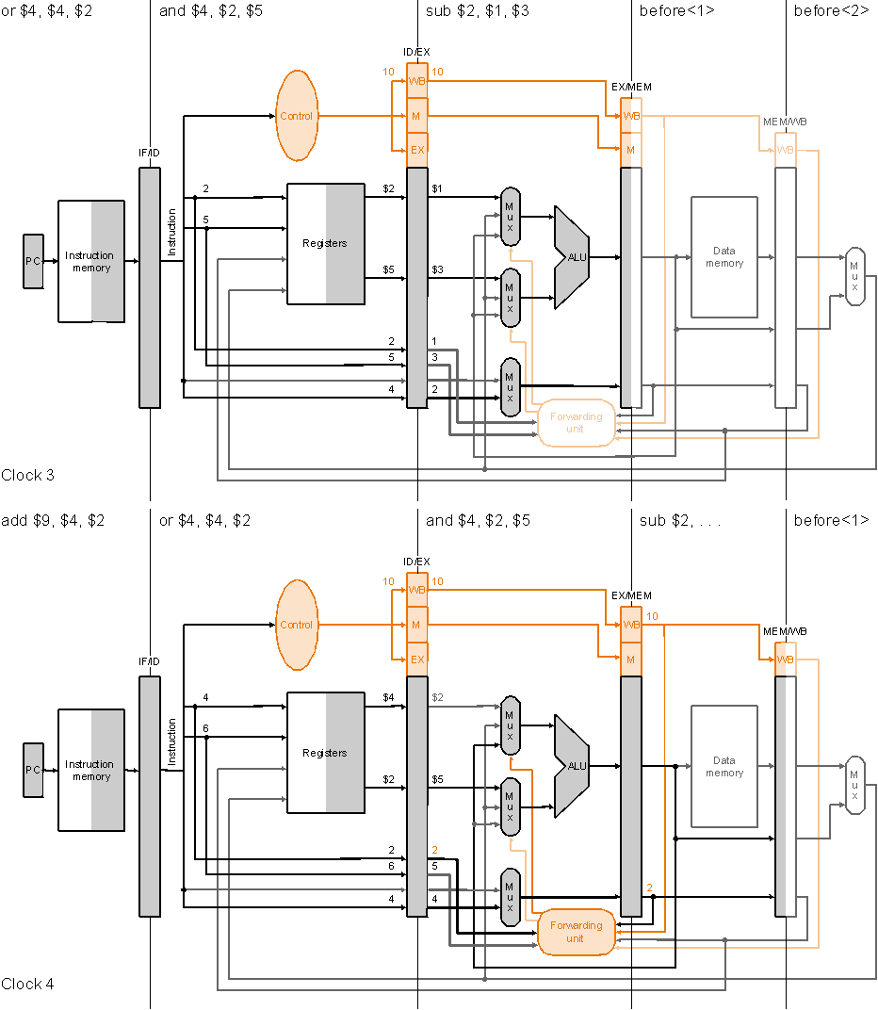
Forwarding
Clock cycle 3
Execution
example:
sub $2, $1, $3
and $4, $2, $5
or $4, $4, $2
add $9, $4, $2
Clock cycle 4

Slide 76
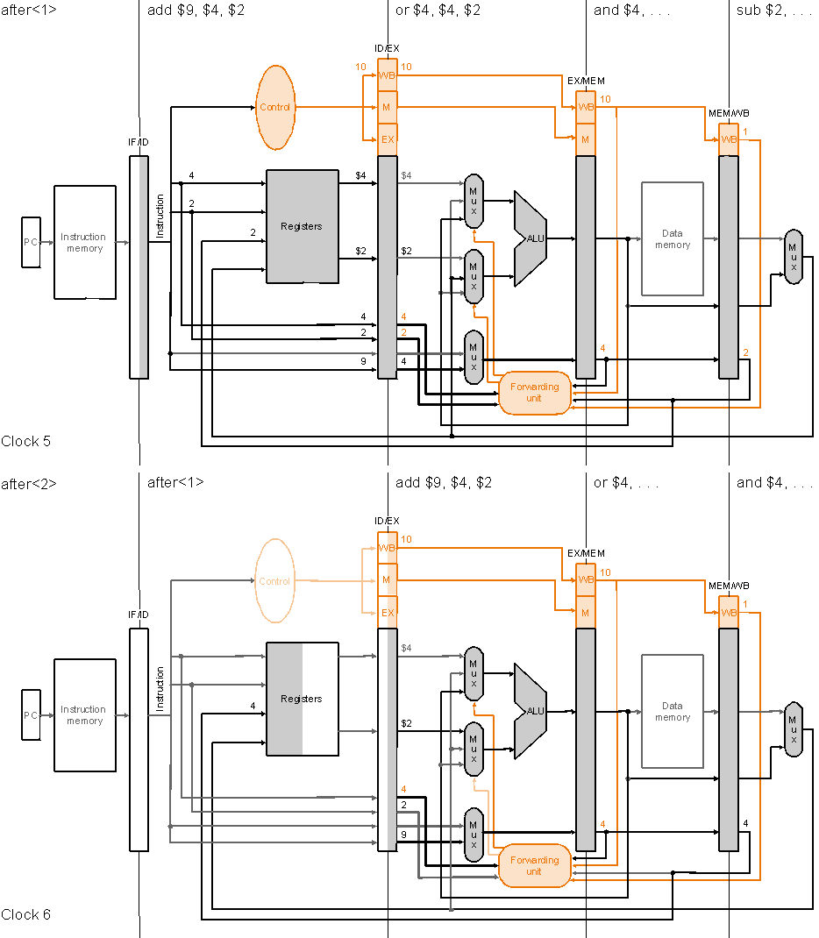
Forwarding
Execution
example
(cont.):
Clock cycle 5
sub $2, $1, $3
and $4, $2, $5
or $4, $4, $2
add $9, $4, $2
Clock cycle 6

Slide 77
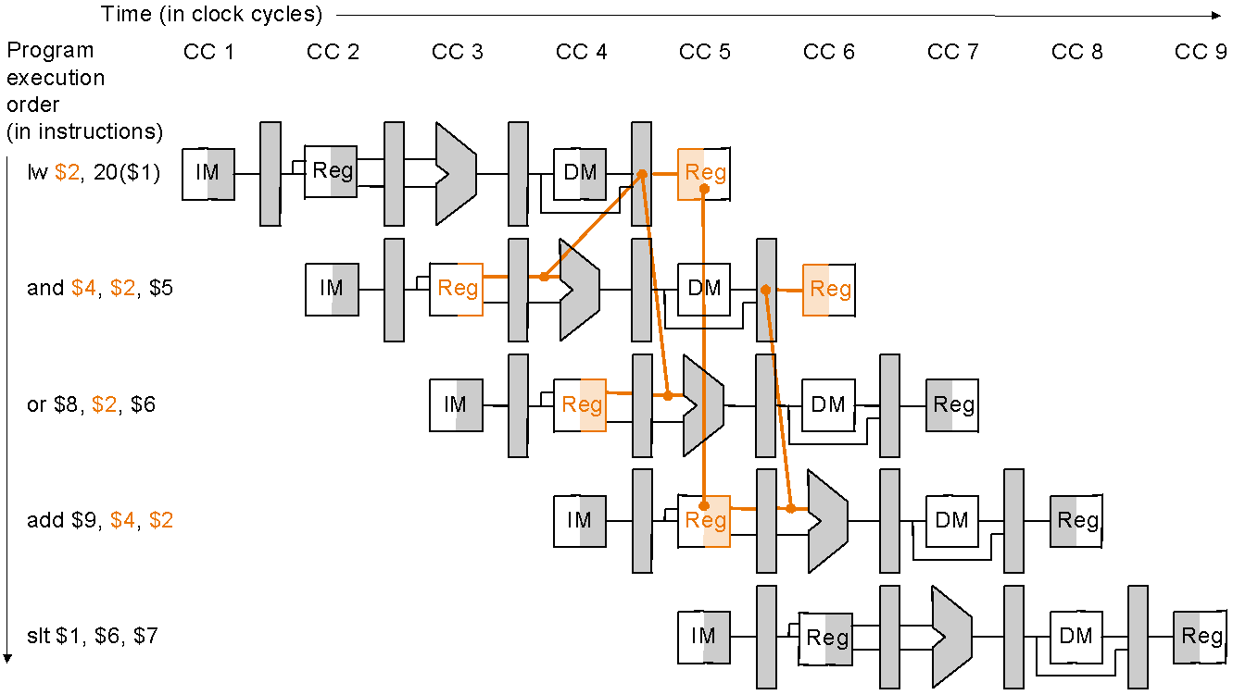
Data Hazards and Stalls
Load word can cause a hazard:
An instruction tries to read a register following a load instruction that writes to the same register
Therefore, we need a hazard detection unit to stall the pipeline after the load instruction
lw $2, 20($1)
and $4, $2, $5
or $8, $2, $6
add $9, $4, $2
Slt $1, $6, $7
As even a pipeline
dependency goes
backward in time
forwarding will not
solve the hazard
Notes:
‹#›

Slide 78
Pipelined Datapath with Control II (as before)
Hazard Detection Unit
Control signals
emanate from
the control
portions of the
pipeline registers
Notes:
‹#›

Slide 79
Hazard Detection Logic to Stall
Hazard detection unit implements the following check at ID stage, if to stall by inserting a bubble into the pipeline by changing the EX, MEM and WB control fields of the ID/EX pipeline register to 0
if ( ID/EX.MemRead // if the instruction in the EX stage is a load…
and ( ( ID/EX.RegisterRt = IF/ID.RegisterRs ) // and the destination register
or ( ID/EX.RegisterRt = IF/ID.RegisterRt ) ) ) // matches either source register
STALL // of the instruction in the ID stage, then…stall the pipeline
Insert a bubble into the EX stage after a load instruction
Bubble is a no-op that wastes one clock cycle
By deasserting all nine control signals (setting them to 0) in EX, MEM and WB stages
Restrict the write operation to any register or memory

Slide 80
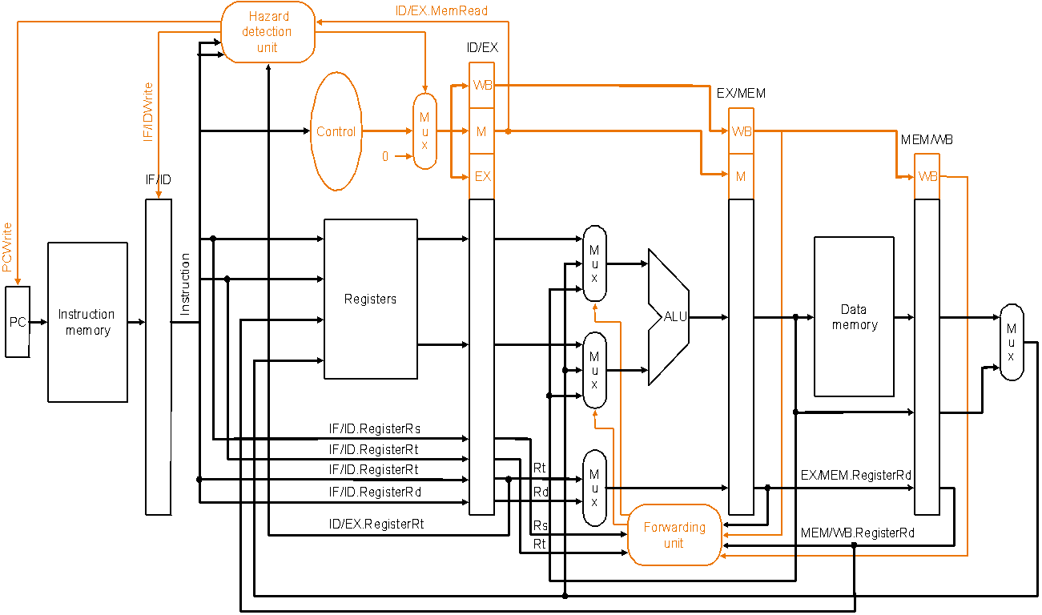
Hazard Detection Unit
Datapath with forwarding hardware, the hazard detection unit and
controls wires – certain details, e.g., branching hardware are omitted
to simplify the drawing
Notes:
‹#›

Slide 81
Mechanics of Stalling
If the check to stall verifies, then the pipeline needs to stall only 1 clock cycle after the load as after that the forwarding unit can resolve the dependency
What the hardware does to stall the pipeline 1 cycle:
does not let the IF/ID register change (disable write!) – this will cause the instruction in the ID stage to repeat, i.e., stall
therefore, the instruction, just behind, in the IF stage must be stalled as well – so hardware does not let the PC change (disable write!) – this will cause the instruction in the IF stage to repeat, i.e., stall
changes all the EX, MEM and WB control fields in the ID/EX pipeline register to 0, so effectively the instruction just behind the load becomes a nop – a bubble is said to have been inserted into the pipeline
note that we cannot turn that instruction into an nop by 0ing all the bits in the instruction itself – recall nop = 00…0 (32 bits) – because it has already been decoded and control signals generated

Slide 82
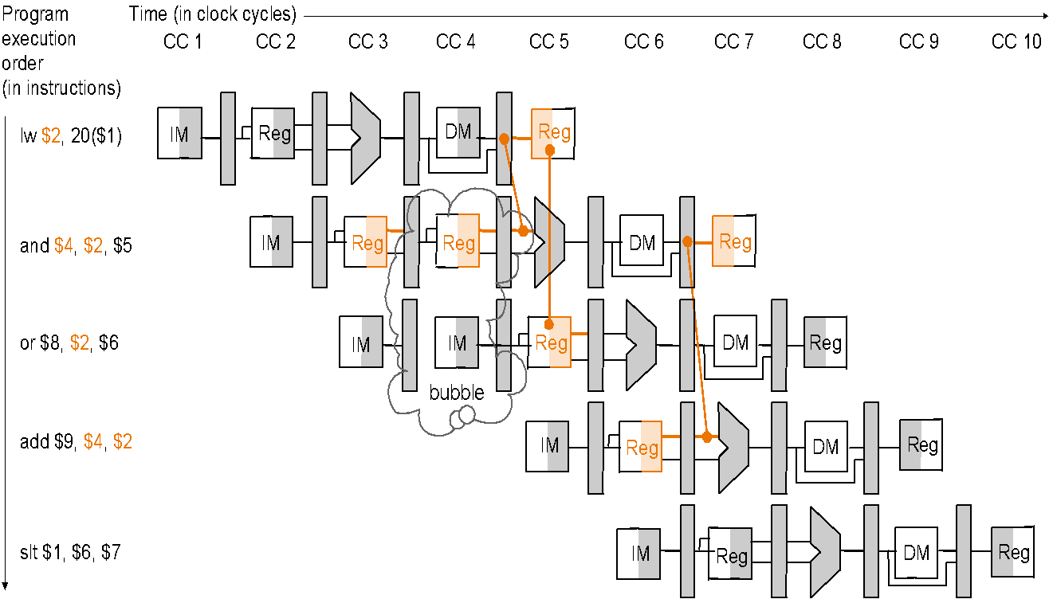
Stalling Resolves a Hazard
Same instruction sequence as before for which forwarding by itself could not resolve the hazard:
lw $2, 20($1)
and $4, $2, $5
or $8, $2, $6
add $9, $4, $2
Slt $1, $6, $7
Hazard detection unit inserts a 1-cycle bubble in the pipeline, after
which all pipeline register dependencies go forward so then the
forwarding unit can handle them and there are no more hazards
Notes:
‹#›

Slide 83
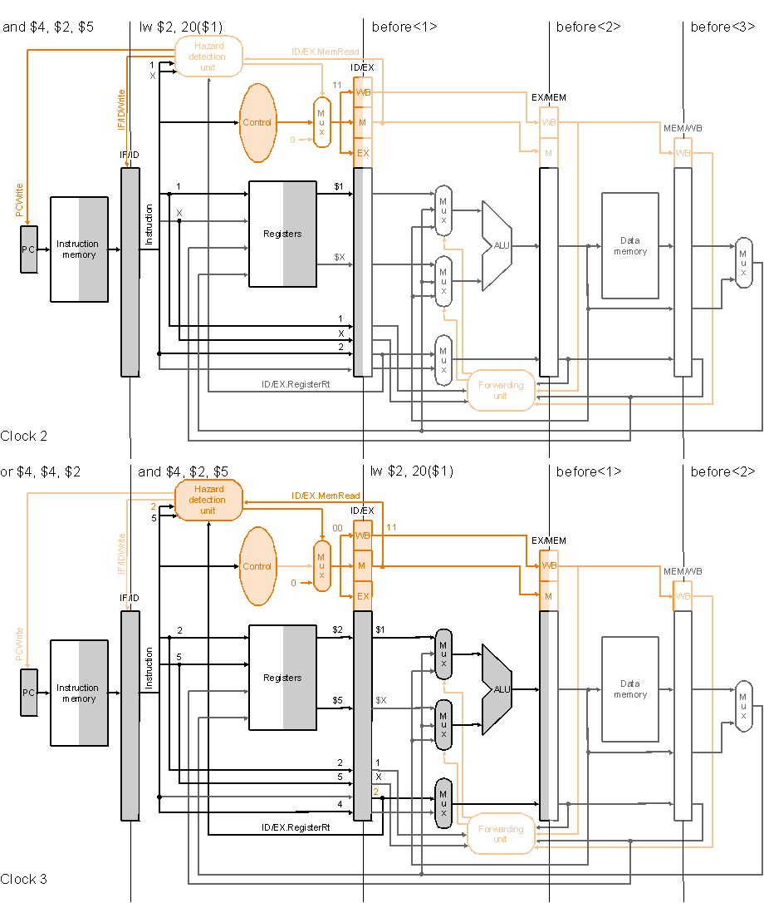
Stalling
Execution
example:
Clock cycle 2
lw $2, 20($1)
and $4, $2, $5
or $4, $4, $2
add $9, $4, $2
Clock cycle 3

Slide 84
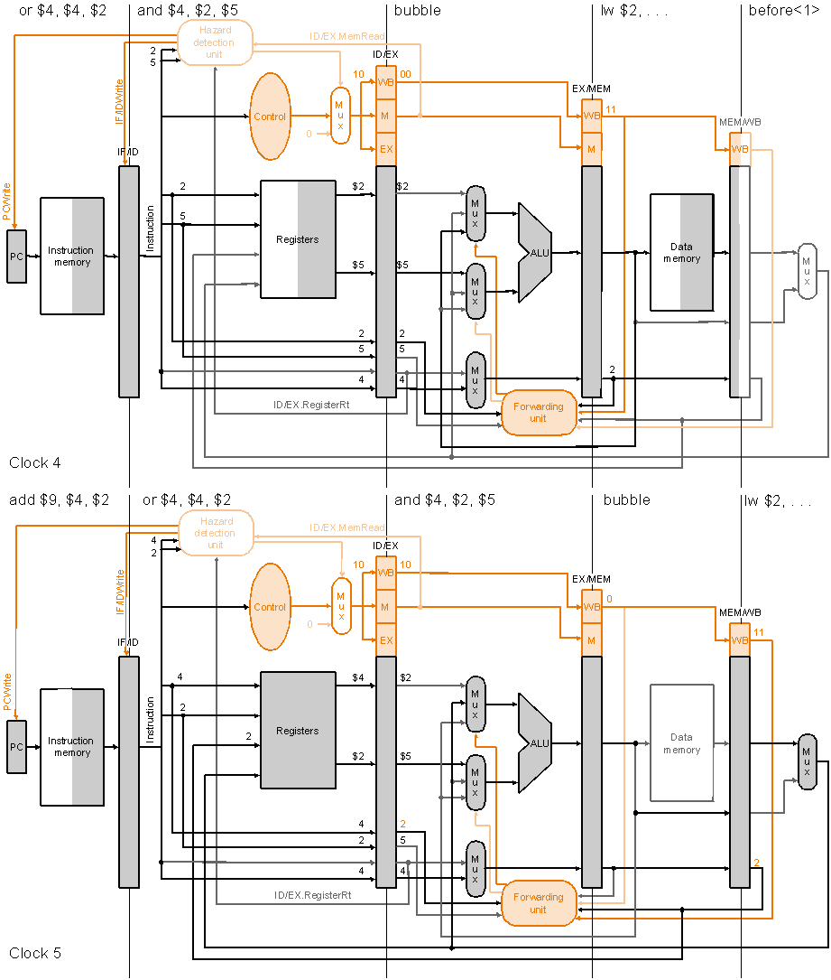
Stalling
Execution
example
(cont.):
Clock cycle 4
lw $2, 20($1)
and $4, $2, $5
or $4, $4, $2
add $9, $4, $2
Clock cycle 5

Slide 85
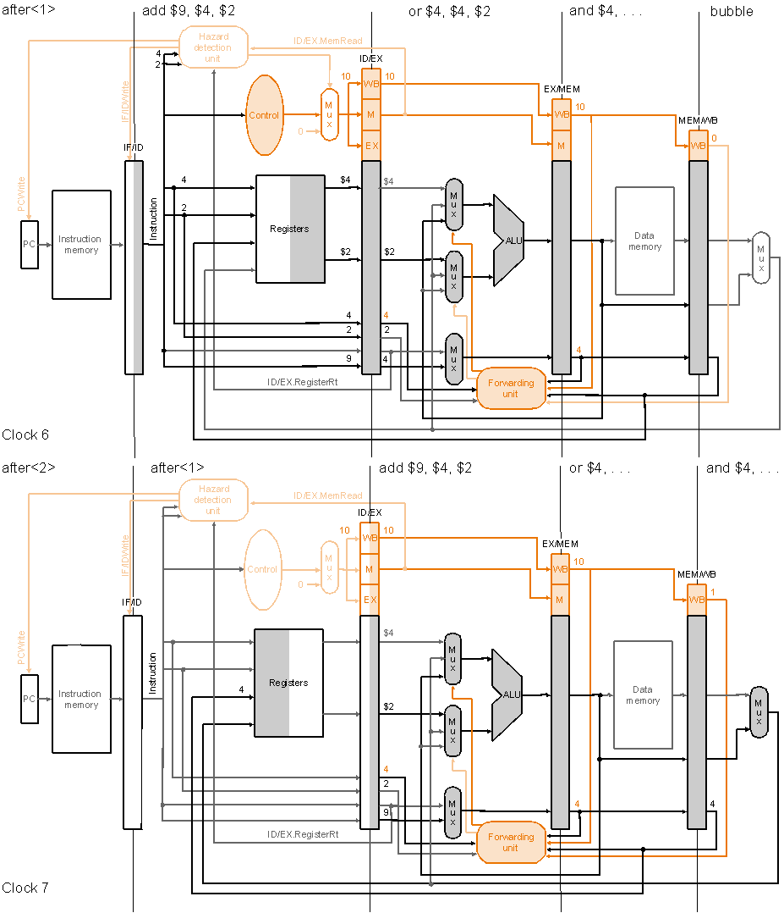
Stalling
Execution
example
(cont.):
Clock cycle 6
lw $2, 20($1)
and $4, $2, $5
or $4, $4, $2
add $9, $4, $2
Clock cycle 7

Slide 86
Control Hazards
Need to make a decision based on the result of a previous instruction still executing in pipeline
Jump and Branch can cause great performance loss
Jump instruction needs only the jump target address
Branch instruction needs two things:
Branch Result Taken or Not Taken
Branch Target Address
PC + 4 If Branch is NOT taken
PC + 4 + 4 × immediate If Branch is Taken

Slide 87
Control Hazards
Solution 1 Stall the pipeline
Control logic detects a Branch instruction in the 2nd Stage
ALU computes the Branch outcome in the 3rd Stage
Next1 and Next2 instructions will be fetched anyway
Convert Next1 and Next2 into bubbles if branch is taken
Branch outcome is computed in ID stage with added hardware (later…)
cc1
cc2
cc3
cc4
cc5
cc6
cc7
Beq $t1,$t2,L1
IF
Reg
ALU
Next1
IF
Reg
Bubble
Bubble
Bubble
Next2
IF
Bubble
Bubble
Bubble
Bubble
L1: target instruction
Branch
Target
Addr
IF
Reg
ALU
DM

Slide 88
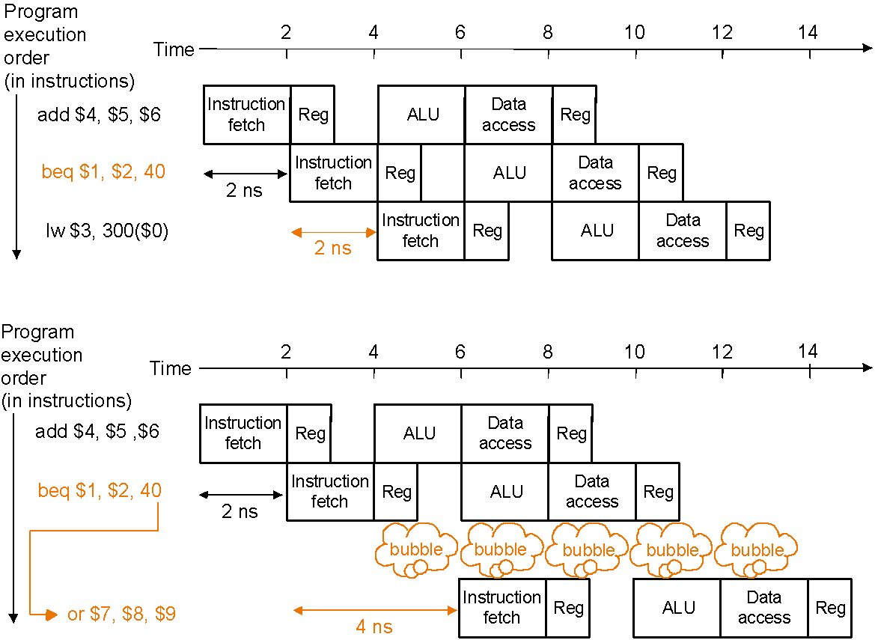
Control Hazards
Solution 2 Predict branch outcome, e.g., predict branch-not-taken :
No waste of cycles, if success
Prediction success
Prediction failure:
undo (=flush) lw

Slide 89
Control Hazards
Solution 3 Delayed branch: always execute the sequentially next statement with the branch executing after one instruction delay
– compiler’s job to find a statement that can be put in the slot that is independent of branch outcome
P
r
o
g
r
a
m
e
x
e
c
u
t
i
o
n
2
4
6
8
1
0
1
2
1
4
o
r
d
e
r
T
i
m
e
(
i
n
i
n
s
t
r
u
c
t
i
o
n
s
)
b
e
q
$
1
,
$
2
,
4
0
I
n
s
t
r
u
c
t
i
o
n
R
e
g
A
L
U
D
a
t
a
R
e
g
f
e
t
c
h
a
c
c
e
s
s
a
d
d
$
4
,
$
5
,
$
6
I
n
s
t
r
u
c
t
i
o
n
R
e
g
A
L
U
D
a
t
a
R
e
g
(
2
n
s
f
e
t
c
h
a
c
c
e
s
s
d
e
l
a
y
e
d
b
r
a
n
c
h
s
l
o
t
)
l
w
$
3
,
3
0
0
(
$
0
)
I
n
s
t
r
u
c
t
i
o
n
R
e
g
A
L
U
D
a
t
a
R
e
g
2
n
s
f
e
t
c
h
a
c
c
e
s
s
2
n
s
Delayed branch beq is followed by add that is independent of branch outcome

Slide 90
Control (or Branch) Hazards
Problem with branches in the pipeline we have so far is that the branch decision is not made till the MEM stage – so what instructions, if at all, should we insert into the pipeline following the branch instructions?
Possible solution: stall the pipeline till branch decision is known
not efficient, slow the pipeline significantly!
Another solution: predict the branch outcome
e.g., always predict branch-not-taken – continue with next sequential instructions
if the prediction is wrong have to flush the pipeline behind the branch – discard instructions already fetched or decoded – and continue execution at the branch target
Is there any other OPTIMAL solution?
Notes:
‹#›

Slide 91
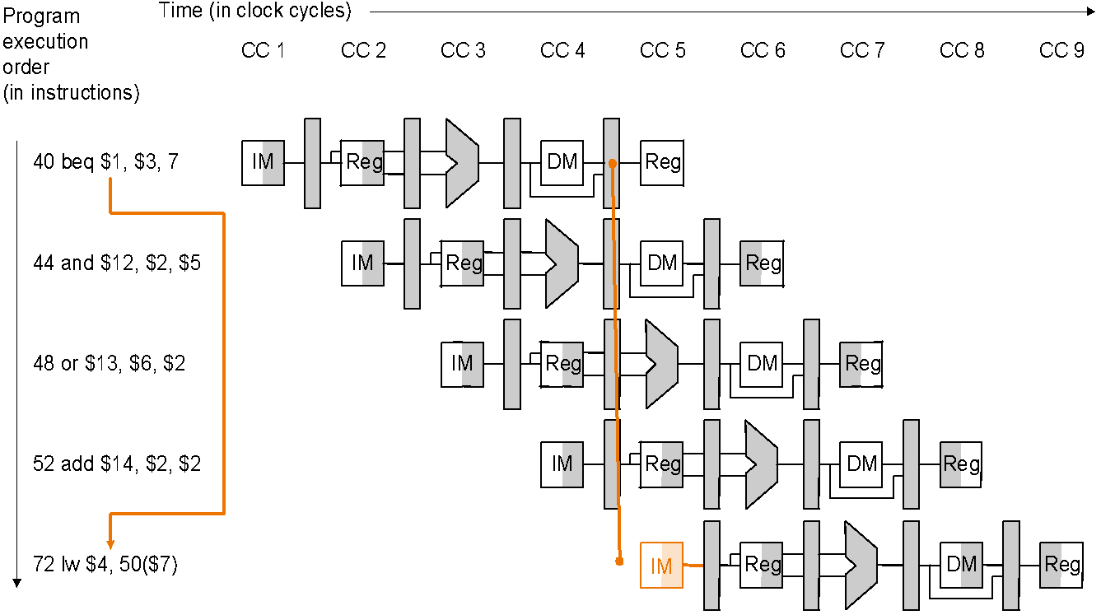
Predicting Branch-not-taken: Misprediction delay
The outcome of branch taken (prediction wrong) is decided only when
beq is in the MEM stage, so the following three sequential instructions
already in the pipeline have to be flushed and execution resumes at lw

Slide 92
Optimizing the Pipeline to Reduce Branch Delay
Move the branch decision from the MEM stage (as in our current pipeline) earlier to the ID stage
calculating the branch target address involves moving the branch adder from the MEM stage to the ID stage – inputs to this adder, the PC value and the immediate fields are already available in the IF/ID pipeline register
calculating the branch decision is efficiently done, e.g., for equality test, by XORing respective bits and then ORing all the results and inverting, rather than using the ALU to subtract and then test for zero (when there is a carry delay)
with the more efficient equality test we can put it in the ID stage without significantly lengthening this stage – remember an objective of pipeline design is to keep pipeline stages balanced
we must correspondingly make additions to the forwarding and hazard detection units to forward to or stall the branch at the ID stage in case the branch decision depends on an earlier result

Slide 93
Flushing on Misprediction
Same strategy as for stalling on load-use data hazard…
Zero out all the control values (or the instruction itself) in pipeline registers for the instructions following the branch that are already in the pipeline – effectively turning them into nops – so they are flushed
in the optimized pipeline, with branch decision made in the ID stage, we have to flush only one instruction in the IF stage – the branch delay penalty is then only one clock cycle

Slide 94
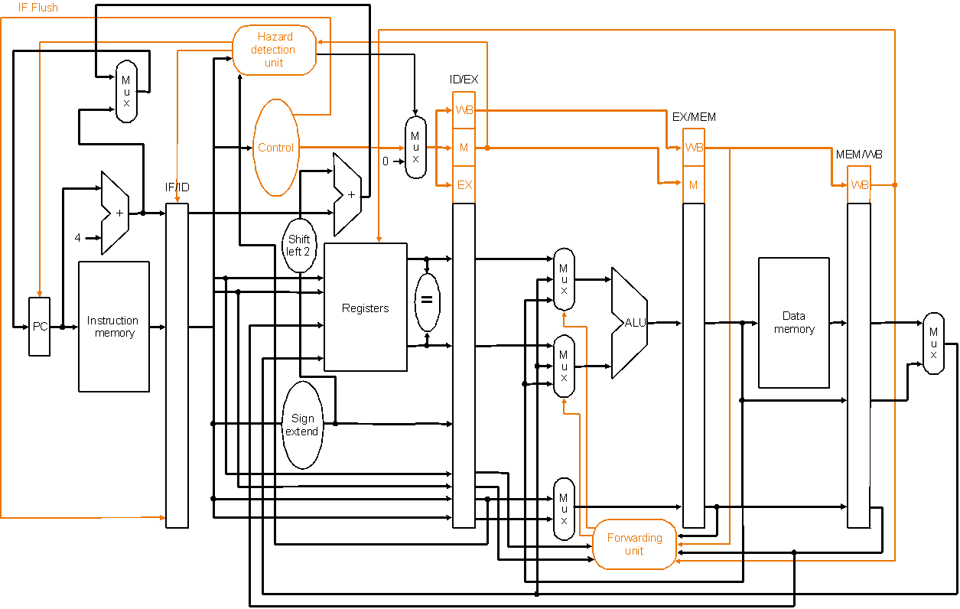
Optimized Datapath for Branch
IF.Flush control zeros out the instruction in the IF/ID
pipeline register (which follows the branch)
Branch decision is moved from the MEM stage to the ID stage – simplified drawing not showing enhancements to the forwarding and hazard detection units

Slide 95
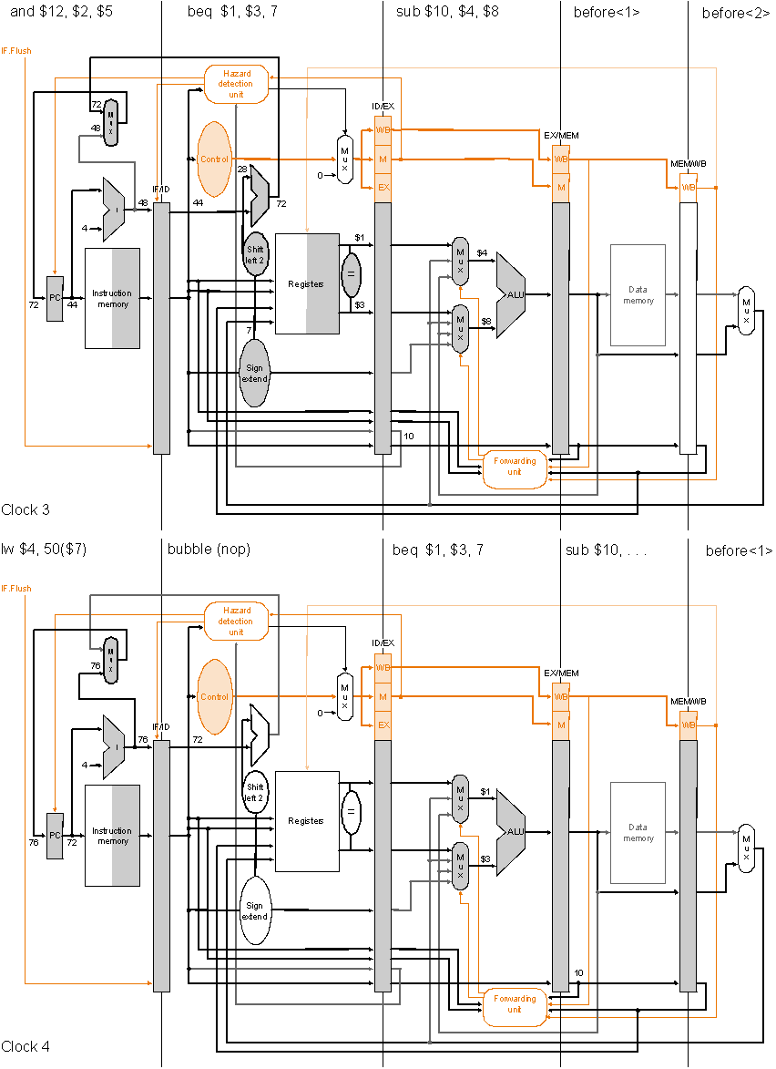
Pipelined Branch
Execution
example:
Clock cycle 3
36 sub $10, $4, $8
40 beq $1, $3, 7
44 and $12 $2, $5
48 or $13 $2, $6
52 add $14, $4, $2
56 slt $15, $6, $7
…
72 lw $4, 50($7)
Optimized pipeline with
only one bubble as a result
of the taken branch
Clock cycle 4

Slide 96
Pipelining Advantages
Higher maximum throughput
Higher utilization of CPU resources
But, more hardware needed, perhaps complex control

Slide 97
Pipelining Exercise
Consider the following MIPS assembly code:
add $3, $2, $3
lw $4, 100($3)
sub $7, $6, $2
xor $6, $4, $3
Assume there is no forwarding or stalling circuitry in a pipelined processor that uses the standard 5-stages (IF, ID, EX, Mem, WB). Instead, we will require the compiler to add no-ops to the code to ensure correct execution. (Assume that if the processor reads and writes to the same register in a given cycle, the value read out will be the new value that is written in.)
Rewrite the code to include the no-ops that are needed. Do not change the order of the four statements. Use as few no-ops as possible.
Suppose the complier is allowed to change the order of the four statements, provided it doesn’t change the final answer. Is it possible to reduce the number of no-ops needed? Why or why not?

Slide 98
Tutorial Question
Draw an execution diagram that shows where forwarding and stalling would take place, if any.
add $6,$5,$2
lw $7,0($6)
addi $7,$7,10
add $6,$4,$2
sw $7,0($6)
addi $2,$2,4
blt $2,$3,loop
add $6,$5,$2

Slide 99
Pipeline
Pipeline depth
It is the number of stages of pipeline.
MIPS-32 processor, pipeline depth is five.

Slide 100
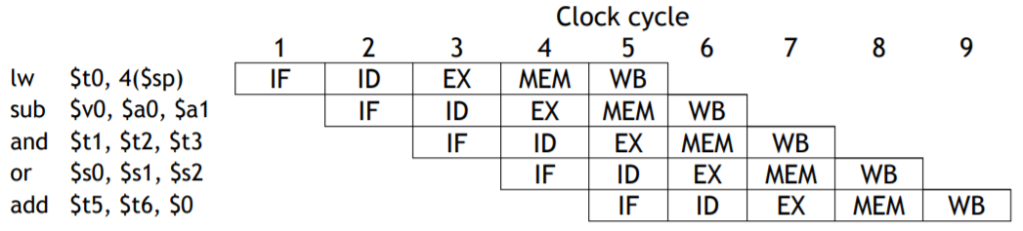
Pipeline
In the first four cycles here, the pipeline is filling, since there are unused functional units.
In cycle 5, the pipeline is full.
Five instructions are being executed simultaneously, so all hardware units are in use.
In cycles 6-9, the pipeline is emptying.

Slide 101
Pipeline Performance Example 1
Consider a pipeline with 4 stages with duration 60, 50, 90 and 80 ns. Given latch delay between stages due to register is 10 ns. Calculate-
Pipeline cycle time
Non-pipeline execution time
Speed up ratio
Pipeline time for 1000 tasks
Sequential time for 1000 tasks
Throughput
Ideal speed up and difference in the current speed up

Slide 102
Solution Example 1
4 stage pipeline is used with Delay of each stages = 60, 50, 90 and 80 ns, Latch delay or delay due to each register = 10 ns
Part-01: Pipeline Cycle Time-
Cycle time
= Maximum delay due to any stage + Delay due to its register
= Max { 60, 50, 90, 80 } + 10 ns
= 90 ns + 10 ns
= 100 ns
Part-02: Non-Pipeline Execution Time-
Non-pipeline execution time for one instruction
= 60 ns + 50 ns + 90 ns + 80 ns
= 280 ns
Part-03: Speed Up Ratio-
Speed up
= Non-pipeline execution time / Pipeline execution time
= 280 ns / Cycle time
= 280 ns / 100 ns
= 2.8
Part-04: Pipeline Time For 1000 Tasks-
Pipeline time for 1000 tasks
= Time taken for 1st task + Time taken for remaining 999 tasks
= 1 x 4 clock cycles + 999 x 1 clock cycle
= 4 x cycle time + 999 x cycle time
= 4 x 100 ns + 999 x 100 ns
= 400 ns + 99900 ns
= 100300 ns
Part-05: Sequential Time For 1000 Tasks-
Non-pipeline time for 1000 tasks
= 1000 x Time taken for one task
= 1000 x 280 ns
= 280000 ns
Part-06: Throughput-
Throughput for pipelined execution
= Number of instructions executed per unit time
= 1000 tasks / 100300 ns

Slide 103
Example 1 – Part 07
In our pipeline, we can execute up to four instructions simultaneously.
That means the maximum speedup is 4 times.
In general, the ideal speedup equals the pipeline depth.
Why was speedup on the previous slide “only” 2.8 times?
The pipeline stages are imbalanced:
A register file and ALU operations can be done in 2ns, but we must stretch that out to 3ns to keep the ID, EX, and WB stages synchronized with IF and MEM. — Balancing the stages is one of the many hard parts in designing a pipelined processor.

Slide 104
Does pipelining improve the execution time of any single instruction?
Pipelining does not improve the execution time of any single instruction.
Each instruction actually takes longer to execute than in a single cycle datapath.
Instead, pipelining increases the throughput, or the amount of work done per unit time as several instructions are executed together in each clock cycle. The result is improved execution time for a sequence of instructions, such as an entire program.

Slide 105
Why and which Control Signals will be propagated through the pipeline registers?
Some of the control signals will not be needed until some later stage and clock cycle. These signals must be propagated through the pipeline until they reach the appropriate stage. We can just pass them in the pipeline registers, along with the other data.
Control signals can be categorized by the pipeline stage that uses them.
EX Stage : ALUSrc ALUOp RegDst
MEM Stage : MemRead MemWrite PCSrc
WB Stage : RegWrite MemToReg

Slide 106
Pipelining and other ISA
Pipelining is harder for older, more complex instruction sets.
If different instructions had different lengths or formats, then the fetch and decode stages would need extra time to determine the actual length of each instruction and the position of the fields.
With memory-to-memory instructions, additional pipeline stages may be needed to compute effective addresses and read memory before the EX stage.

Slide 107
Microprocessor without Interlocked Pipeline Stages (MIPS)
The hardware to detect a data hazard and stall the pipeline until the hazard is cleared is called a pipeline interlock
Example 1:
SUB $s1, $s3, $s4
AND $s2, $s1, $s3
A pipeline interlock does not have to be used with any data forwarding, however. In the example where the SUB followed by AND and the second example of LW followed by AND can be solved by stalling the first stage by three cycles until write-back is achieved, and the data in the register file is correct, causing the correct register value to be fetched by the AND's Decode stage. This causes quite a performance hit, as the processor spends a lot of time processing nothing, but clock speeds can be increased as there is less forwarding logic to wait for.
Example 2:
LW $s1, 4($s2)
AND $s3, $s1, $s2

Slide 108
Microprocessor without Interlocked Pipeline Stages (MIPS)
These data hazards can be detected quite easily when the program's machine code is written by the compiler.
The MIPS machine relied on the compiler to add the NOP instructions in this case, rather than having the circuitry to detect and (more taxingly) stall the first two pipeline stages.
Hence the name MIPS: Microprocessor without Interlocked Pipeline Stages.
It turned out that the extra NOP instructions added by the compiler expanded the program binaries enough that the instruction cache hit rate was reduced.
The stall hardware, although expensive, was put back into later designs to improve instruction cache hit rate, at which point the acronym no longer made sense.
Example 1:
SUB $s1, $s3, $s4
AND $s2, $s1, $s3
Example 2:
LW $s1, 4($s2)
AND $s3, $s1, $s2

Slide 109
Simple Example: Comparing Performance
Compare performance for single-cycle, multicycle, and pipelined datapaths using the gcc instruction mix
assume 2 ns for memory access, 2 ns for ALU operation, 1 ns for register read or write
assume gcc instruction mix 23% loads, 13% stores, 19% branches, 2% jumps, 43% ALU
for pipelined execution assume
50% of the loads are followed immediately by an instruction that uses the result of the load
25% of branches are mispredicted
branch delay on misprediction is 1 clock cycle
jumps always incur 1 clock cycle delay so their average time is 2 clock cycles

Slide 110
Simple Example: Comparing Performance
Single-cycle (p. 373): average instruction time 8 ns
Multicycle (p. 397): average instruction time 8.04 ns
Pipelined:
loads use 1 cc (clock cycle) when no load-use dependency and 2 cc when there is dependency – given 50% of loads are followed by dependency the average cc per load is 1.5
stores use 1 cc each
branches use 1 cc when predicted correctly and 2 cc when not – given 25% misprediction average cc per branch is 1.25
jumps use 2 cc each
ALU instructions use 1 cc each
therefore, average CPI is
1.5 × 23% + 1 × 13% + 1.25 × 19% + 2 × 2% + 1 × 43% = 1.18
therefore, average instruction time is 1.18 × 2 = 2.36 ns
50% of the loads are followed immediately by an instruction that uses the result of the load
25% of branches are mispredicted
branch delay on misprediction is 1 clock cycle
jumps always incur 1 clock cycle delay so their average time is 2 clock cycles

Slide 111
Summary-Pipeline Hazards
Structural hazards
Caused by resource contention
Two operations require a single piece of hardware e.g. Memory
Using same resource by two instructions during the same cycle
Structural hazards can be overcome by adding additional hardware
Data hazards
Instruction from one pipeline stage is “dependant” of data computed in previous pipeline stage
Hardware can detect dependencies between instructions
Control hazards
Caused by instructions that change control flow (branches/jumps)
i.e. delays in changing the flow of control
Requiring subsequent instruction fetches to be predicted
Flushed if prediction does not hold (make sure no state change)
Branch hazards can use dynamic prediction/speculation, branch delay slot

Slide 112
Refer
Patterson Chapter 6: Topics 6.1 to 6.6

Slide 113
End…

Slide 114
Pipelined Datapath with Control II
Control signals
emanate from
the control
portions of the
pipeline registers
Notes:
‹#›

Slide 115
Pipelined Execution and Control
Clock cycle 1
Instruction sequence:
Dark Right Area indicates the Read Operation
Dark Left Area indicates the Write Operation
lw $10, 20($1)
sub $11, $2, $3
and $12, $4, $7
or $13, $6, $7
add $14, $8, $9
Label “before<i>” means
i th instruction before
lw
Clock cycle 2

Slide 116
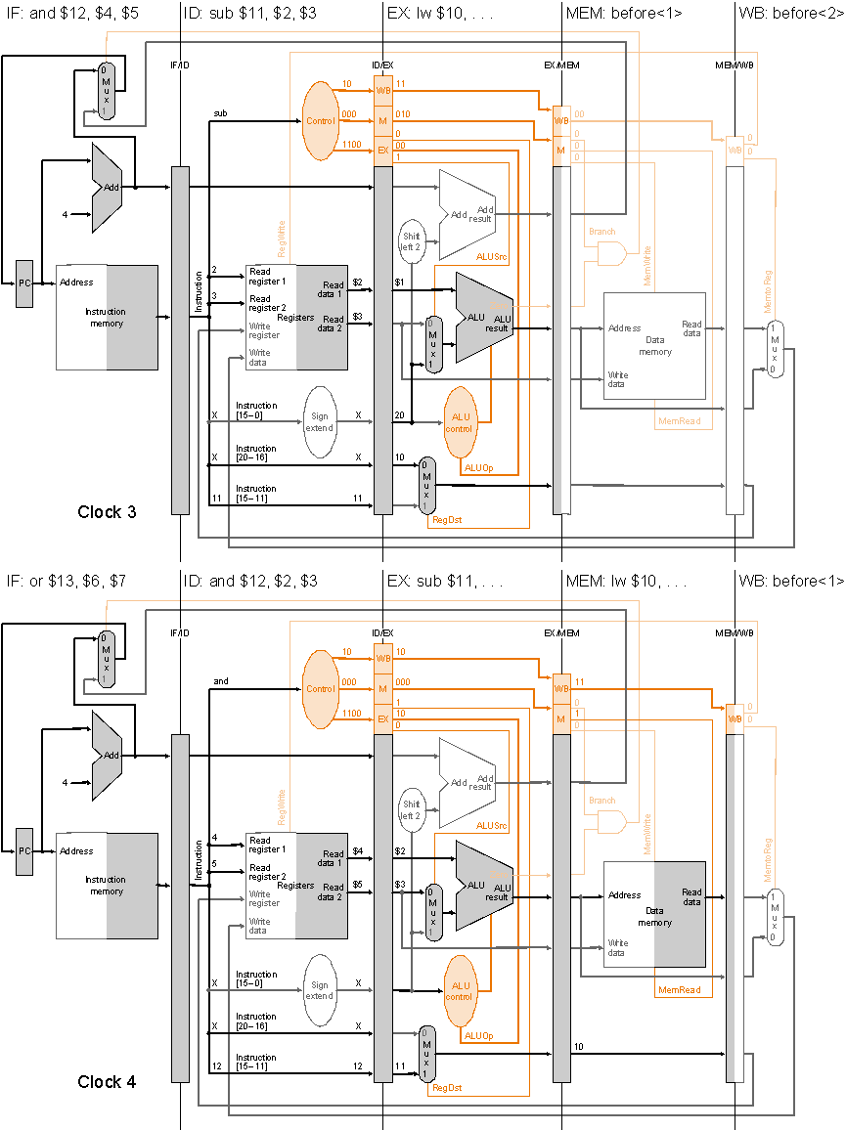
Pipelined Execution and Control
Clock cycle 3
Instruction
sequence:
lw $10, 20($1)
sub $11, $2, $3
and $12, $4, $7
or $13, $6, $7
add $14, $8, $9
Clock cycle 4

Slide 117
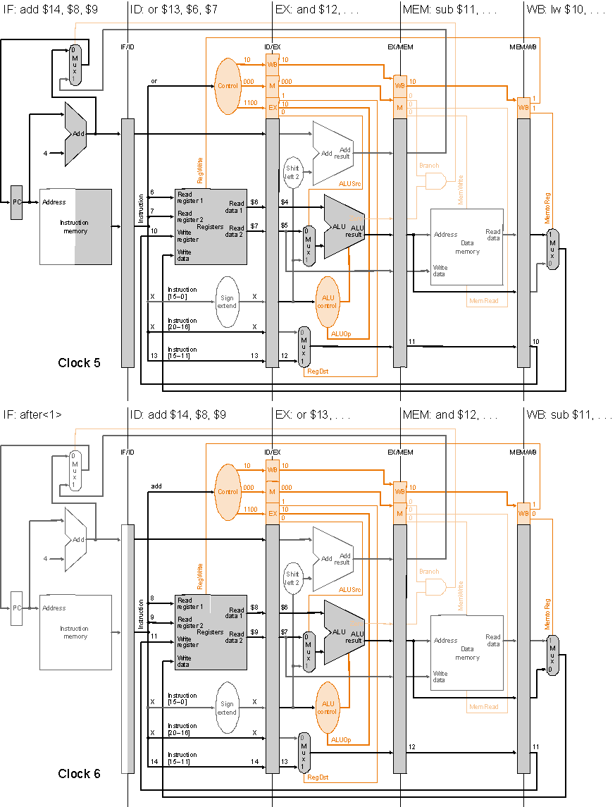
Pipelined Execution and Control
Clock cycle 5
Instruction
sequence:
lw $10, 20($1)
sub $11, $2, $3
and $12, $4, $7
or $13, $6, $7
add $14, $8, $9
Label “after<i>” means
i th instruction after add
Clock cycle 6

Slide 118
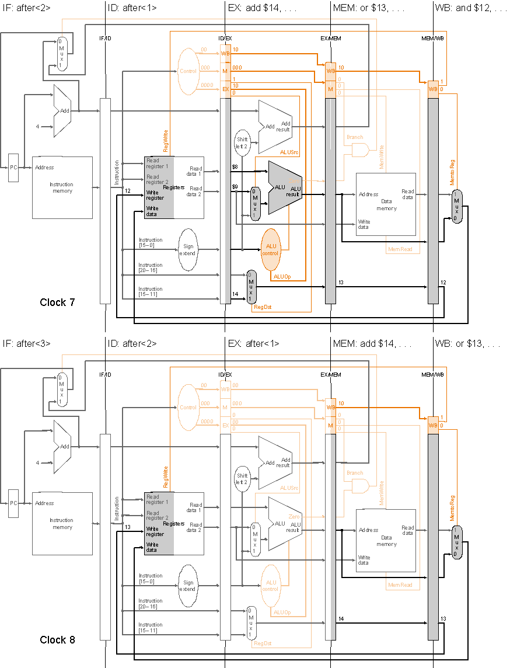
Pipelined Execution and Control
Clock cycle 7
Instruction
sequence:
lw $10, 20($1)
sub $11, $2, $3
and $12, $4, $7
or $13, $6, $7
add $14, $8, $9
Clock cycle 8

Slide 119
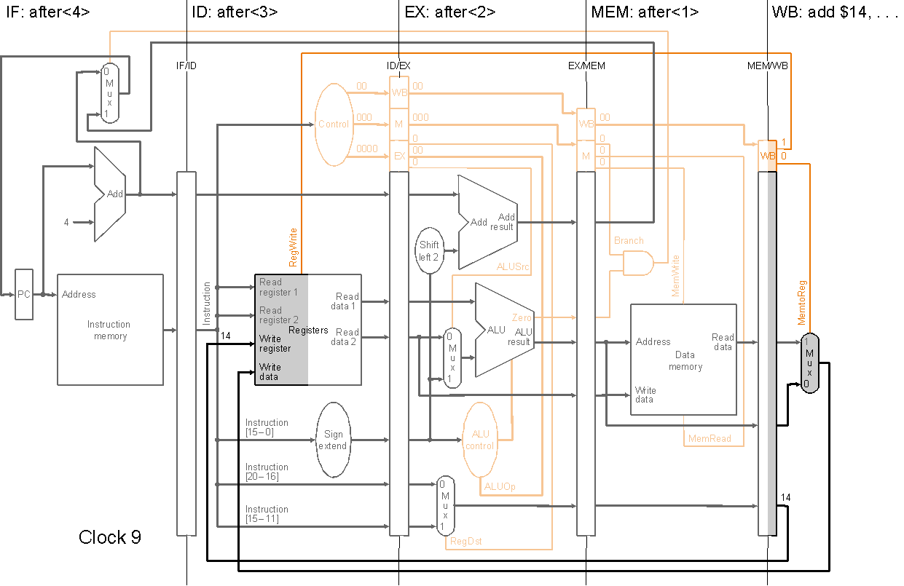
Pipelined Execution and Control
Instruction
sequence:
lw $10, 20($1)
sub $11, $2, $3
and $12, $4, $7
or $13, $6, $7
add $14, $8, $9
Clock cycle 9

